Slide 1



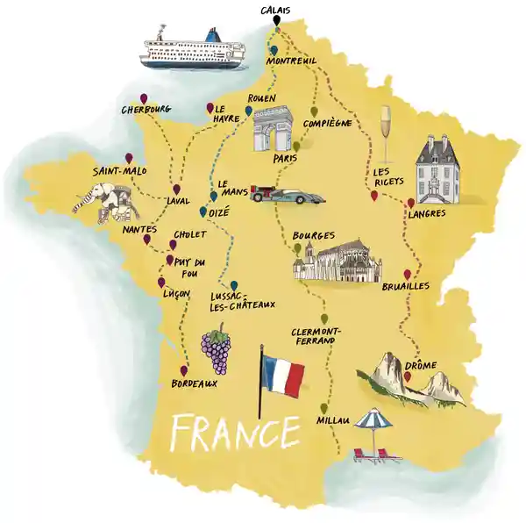

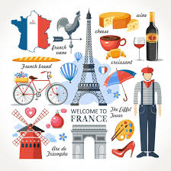
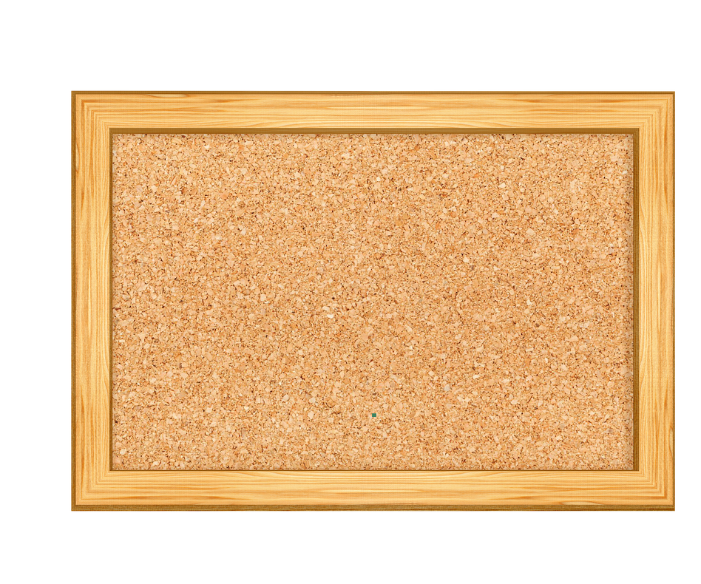



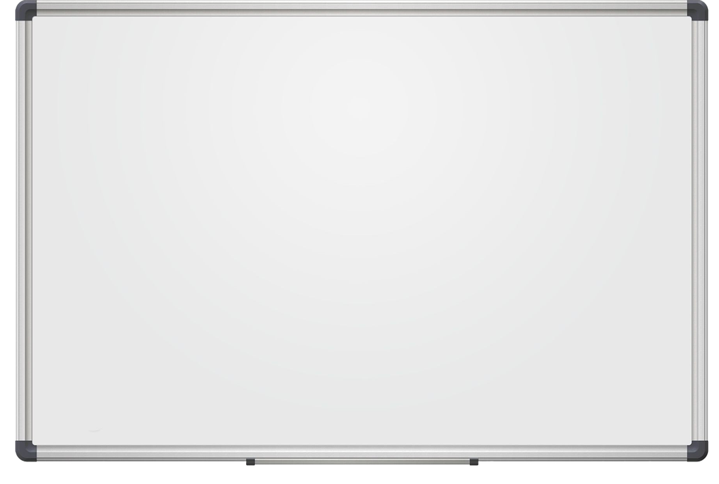

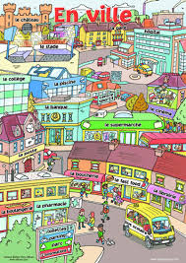






mardi le 18 avril 2024
Salut! Bonjour!
Les pays francophones

Slide 2

mardi le 18 avril 2024
You are going to watch a video - write down all the countries mentioned
Click here to watch

Slide 3
mardi le 18 juin 2024
How many did you get? These are called
Les pays francophones - they are countries where people speak French

Slide 4
Now print a world map - click here - and colour the countries you saw on the video - go back to it - pause it and look at each one - the video shows you where each one is.

Slide 5
Now decide which one would you visit - why?

Slide 6
Finally, make your own picture and/ or fact file about the country you have chosen
OR design and write a postcard - (click for template)in English as if you were there - where are you; for how long; what’s the weather like; what you have seen and where you have been in the country

Slide 7
Excellent - I’m looking forward to receiving your factfiles/ postcards and making a display when we’re all get back to school!

Slide 8
mardi le 2 juin 2020
Now click around the classroom and see what else is hidden

