Slide 1
Using Kagan Structures in EYFS
Mrs Box and Miss Elston

Slide 2
Why we decided to use Kagan structures
'Working co-operatively in teams is a wonderful experience for students and provides opportunities for students to develop social and life skills that will serve them well throughout life' - Dr Spencer Kagan
The structures eliminate the typical classroom scenario of ‘hogs and logs’, whereby few children (the hogs) typically answer all of the questions, allowing the rest of the class (the logs) to be passive. Kagan Structures ensure all children are active participants in learning and that everyone is held accountable. They also enable the children to develop their inter-personal skills through active listening, collaboration and presenting. They are effective because every pupil shares in the successes of the group, having all played their part in the set task.

Slide 3
Which structures have we implemented?
Nursery –
Timed pair share
Reception classes –
Timed Pair Share
Stand up, Hand up, Mix up, Pair Share
Round Robin

Slide 4
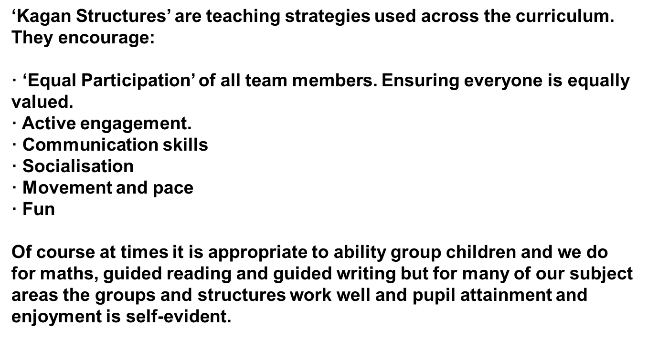
When do we use kagan structures:

Slide 5
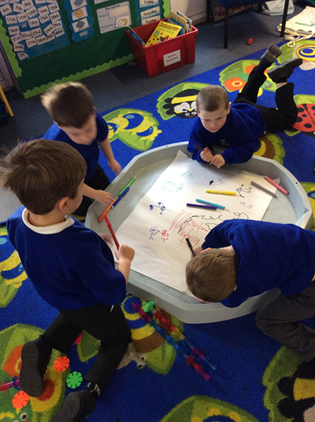
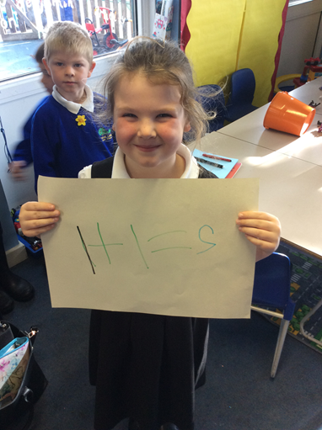
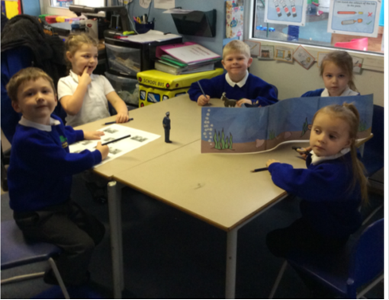
How the structures have IMPROVED independent/ collaborative learning

Slide 6
Next steps
Continue using structures.
Introduce ‘Stand up, Mix up, Hand up, Pair Share’ in Nursery.
Begin using visual prompts to indicate use of structure. Transfer these visual prompts into child initiated play
Parental involvement. Information about the structures to be shared with parents on Family Friday.

