Slide 1

Questioning in Year 3
By Mrs Rudland
and Miss Porter

Slide 2
What are we doing?
Looking at how we question the children
WHY?
To extend the children’s thinking
To get broader and deeper answers
To enable children to make links in their learning
To create a more child-led learning environment

Slide 3
What are the children doing?
Looking at how the children question themselves and others
WHY?
To elaborate on ideas
To make them think outside the box
To question their thinking and the thinking of others
To develop their articulacy when demonstrating their understanding

Slide 4
Where the children/teachers started at?
Children
Teachers
Answered with basic/obvious answers
Not extending or thinking outside the box
Unable to generate thoughtful questions to pose to other children
Not asking enough open questions
Didn’t always give the children a chance to ask questions for themselves
Didn’t give them enough opportunities to then share these questions

Slide 5
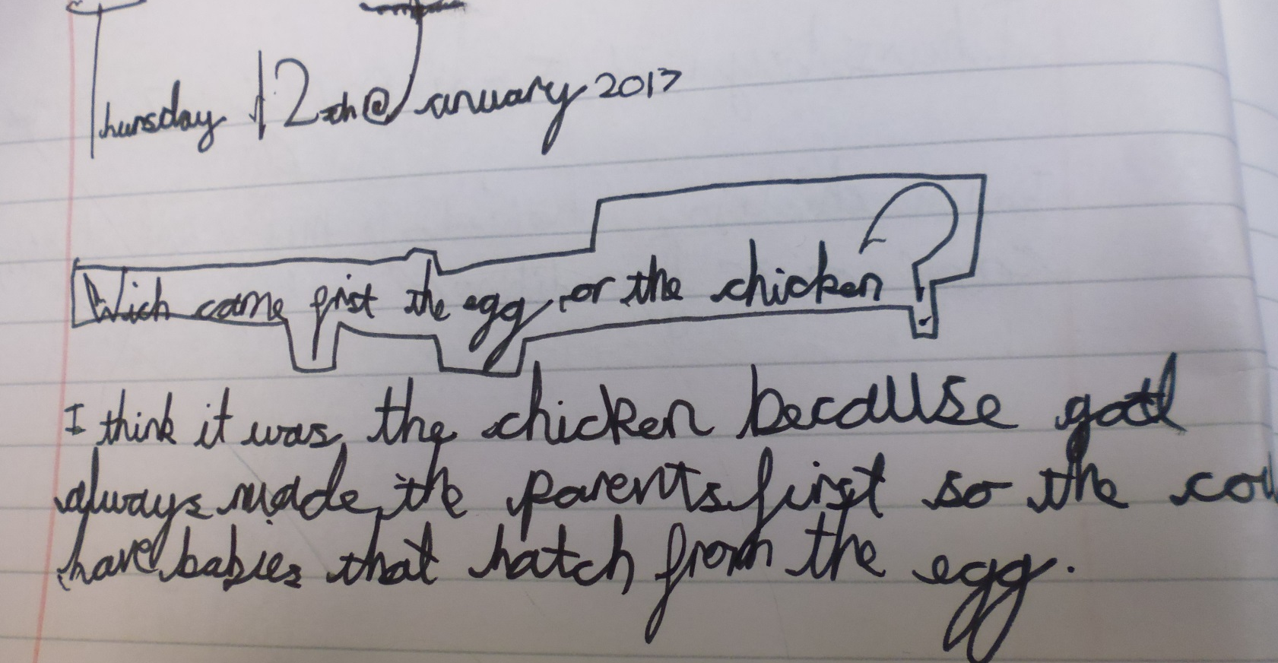
What are we doing?
Morning Work
Asking and responding to open questions - making links to other subjects.
e.g. Which came first – the chicken or the egg?

Slide 6
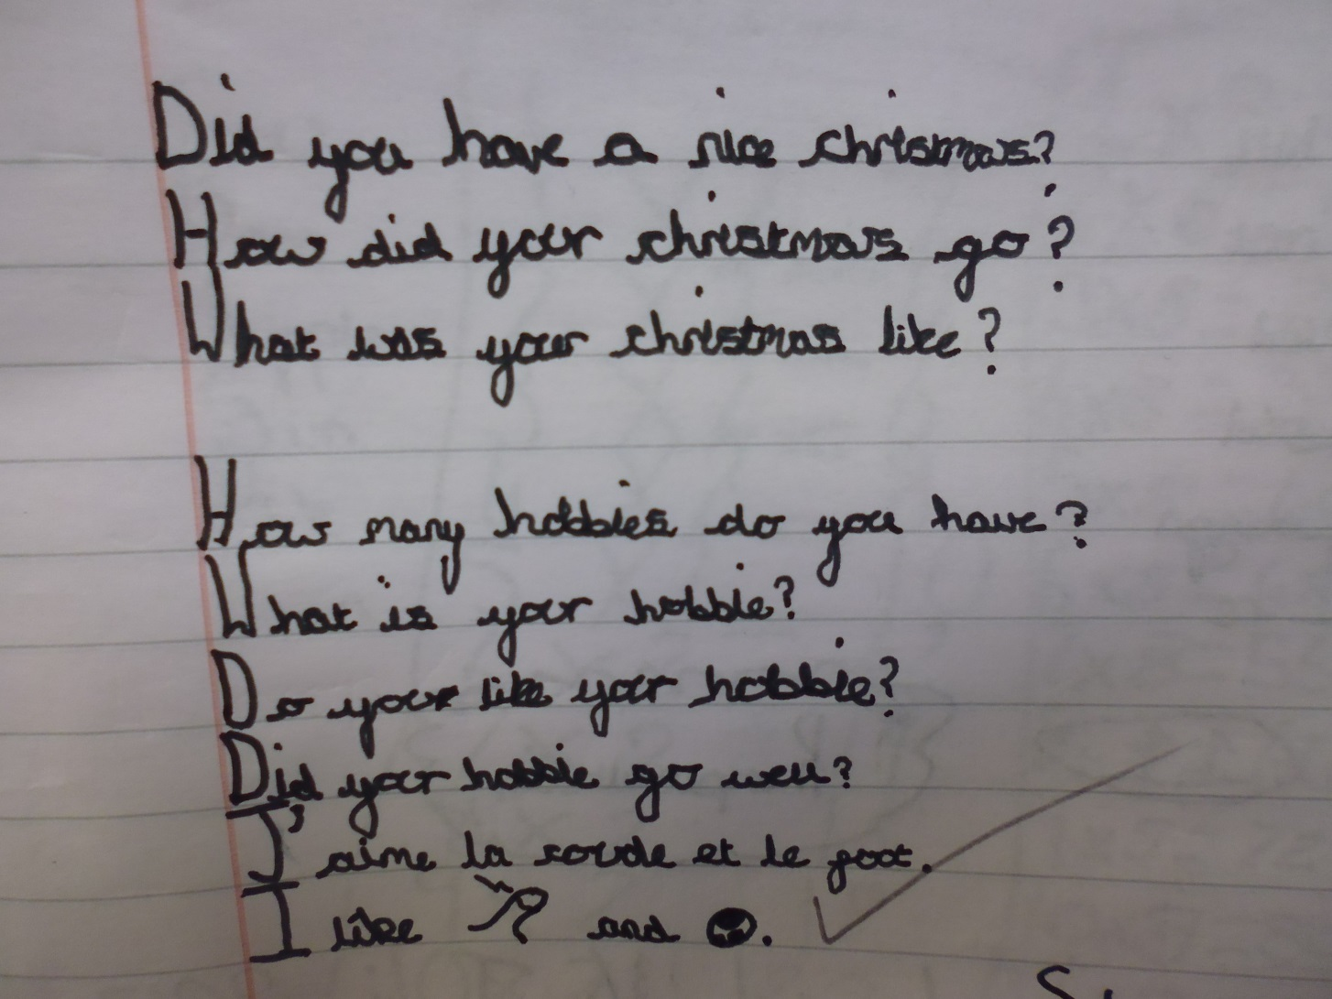
Giving opportunities to question each other. Linking it in with other subjects.
The children asked each other the questions.

Slide 7
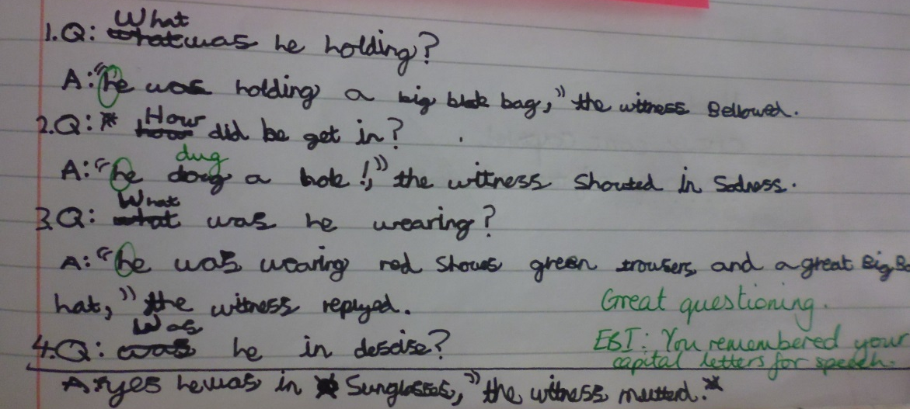
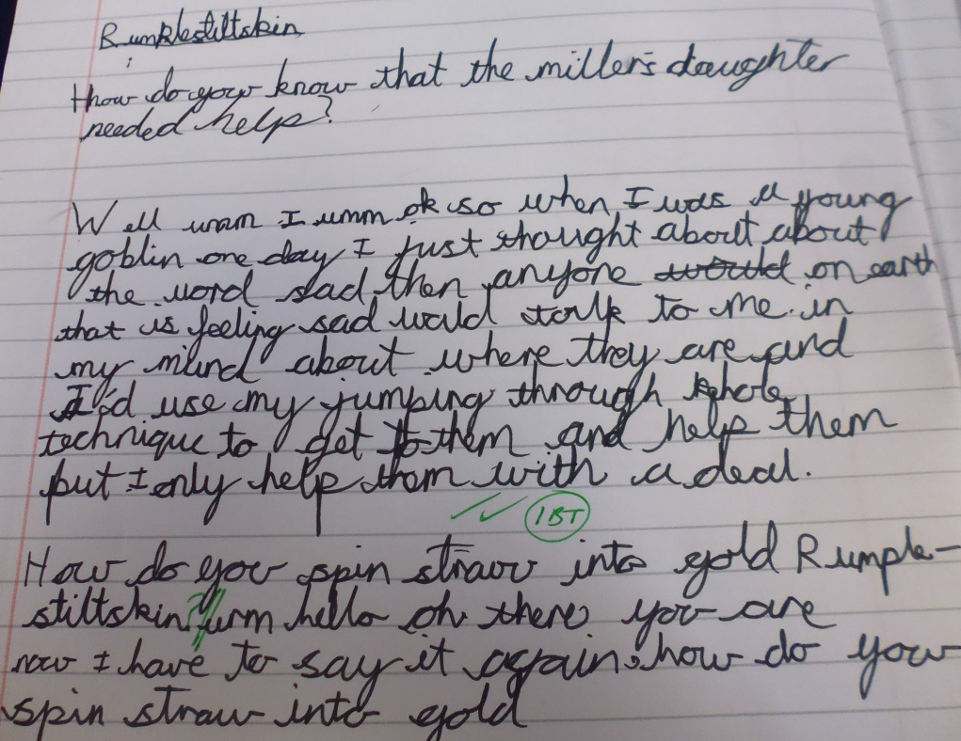
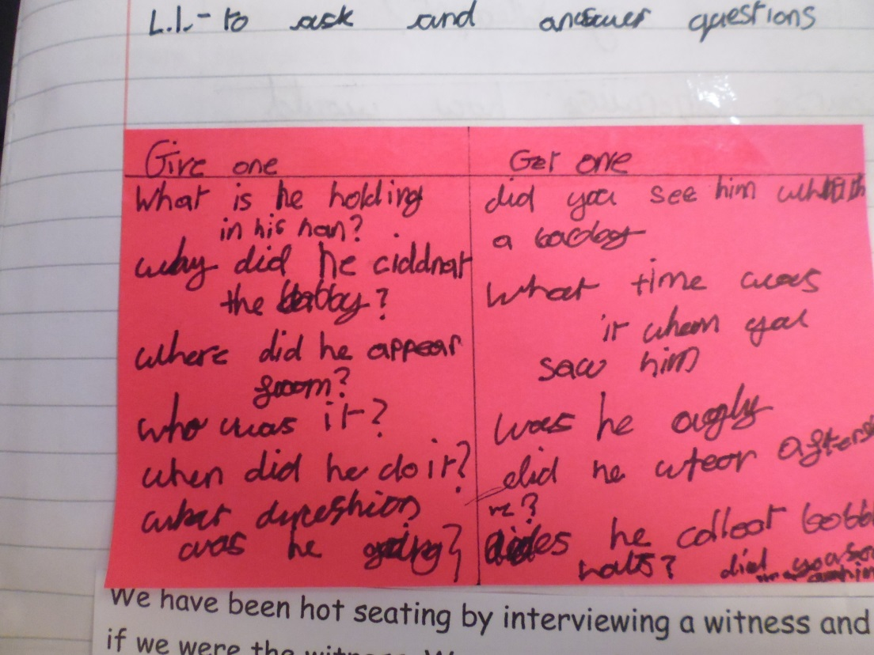
What are we doing in Literacy?
Class work

Slide 8
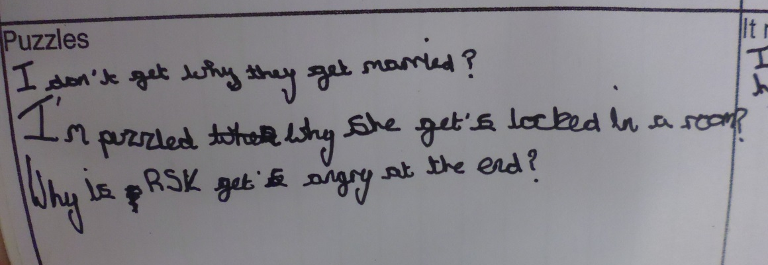
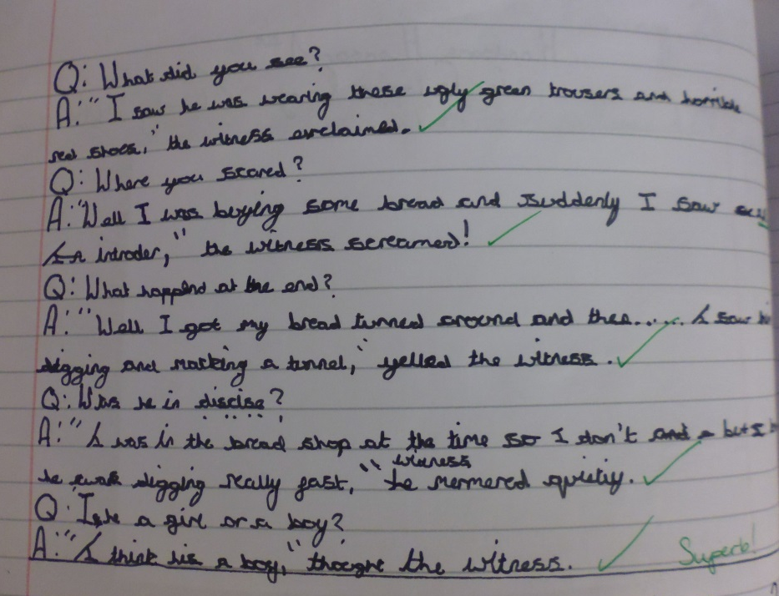
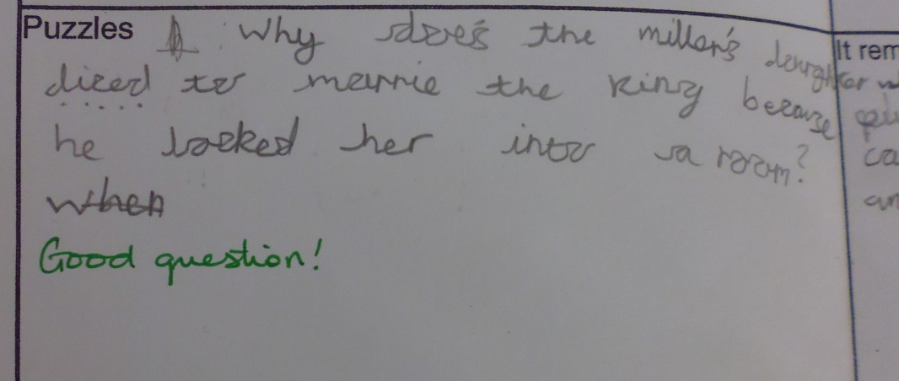
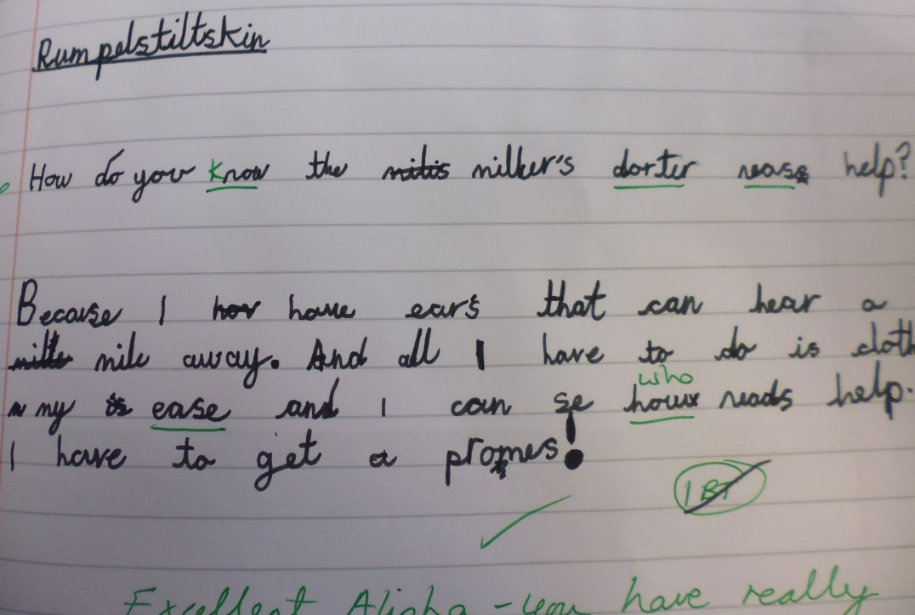
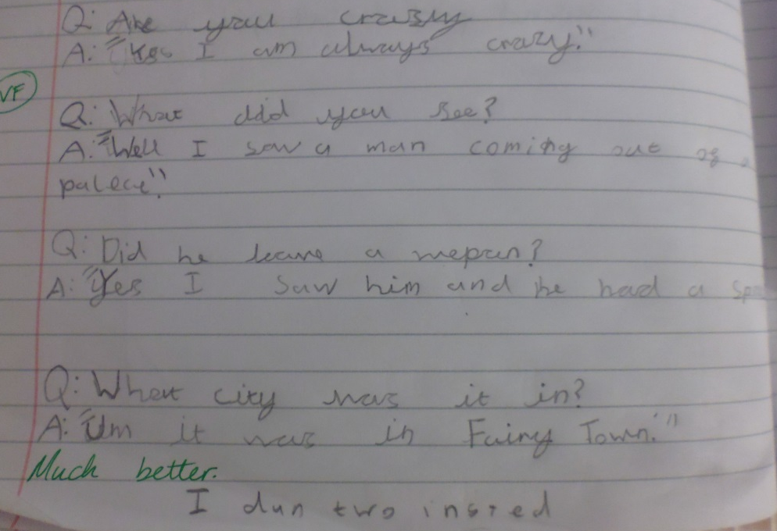

Slide 9
What are we doing in Numeracy?
Class work
‘My friend says…’
Using the Quick 6 to write their own word problem questions
Discussions with partners
Question are posed to constantly question the children’s thinking
Problem solving activities
Persevering – having that ‘can do’ attitude

Slide 10
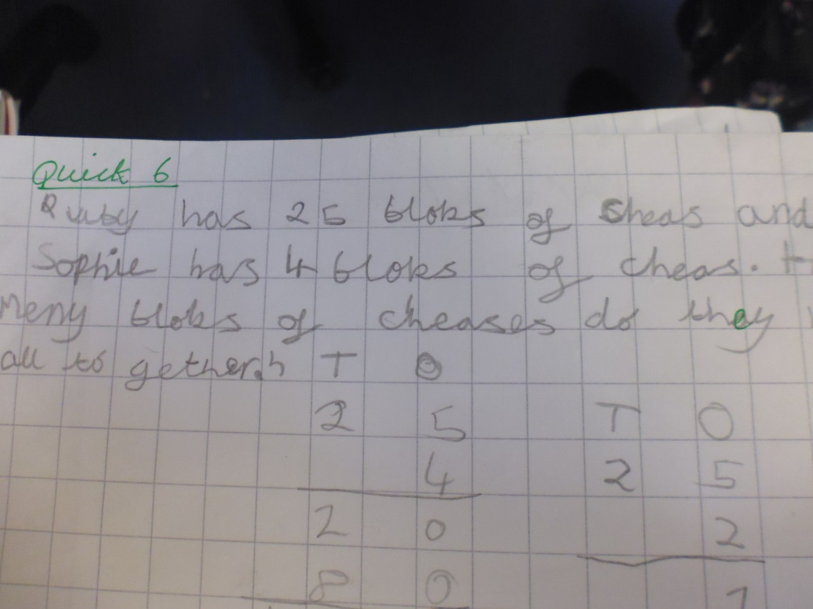
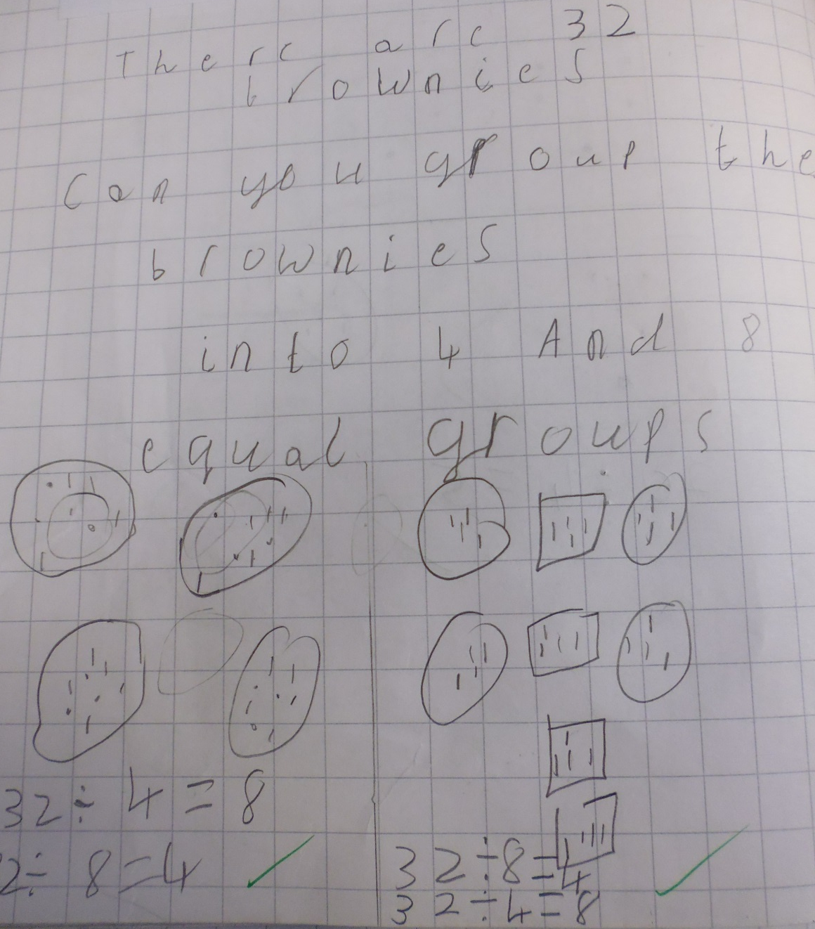

Slide 11
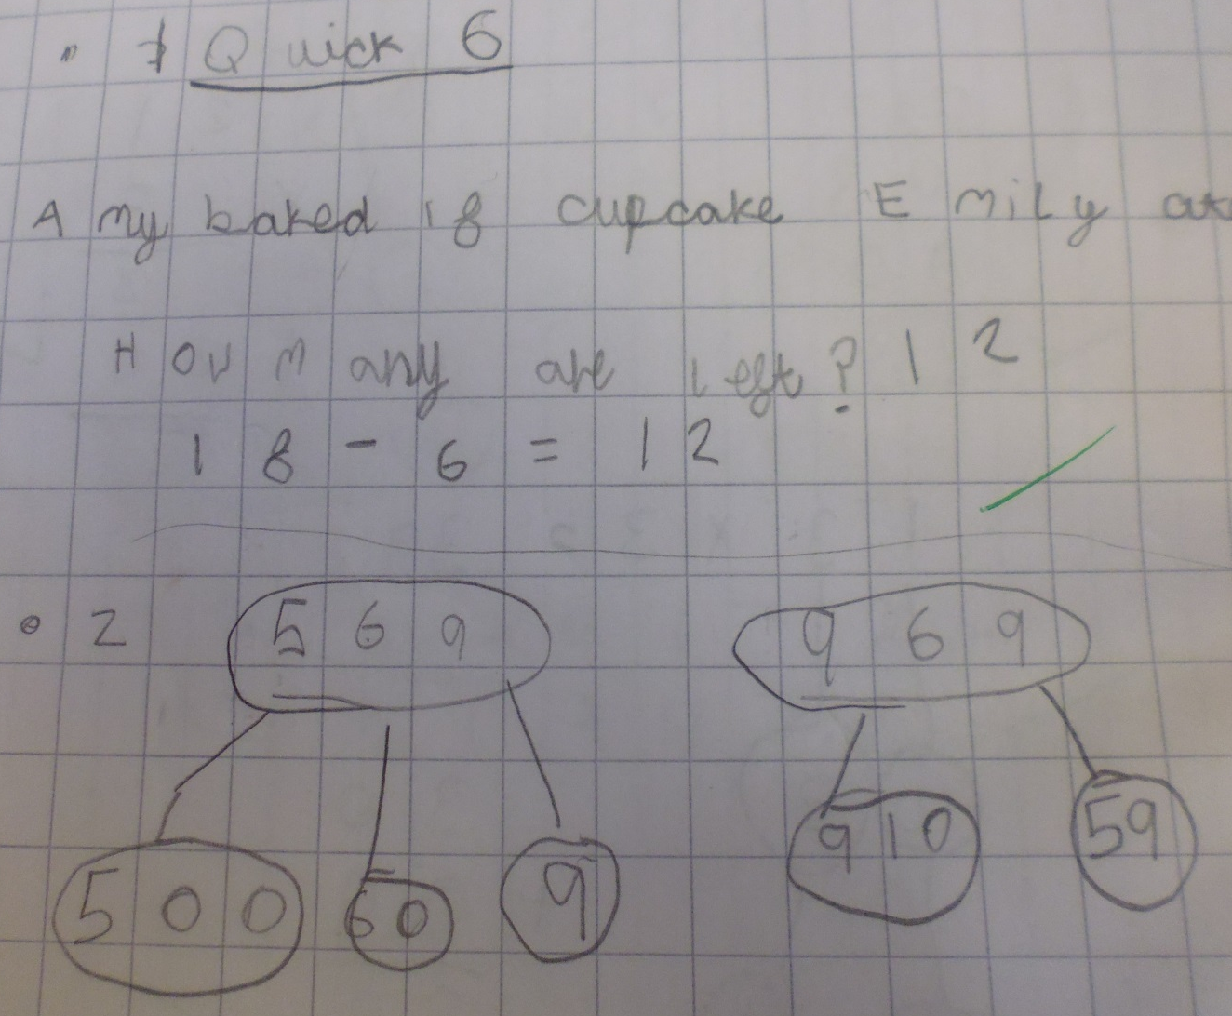

Slide 12
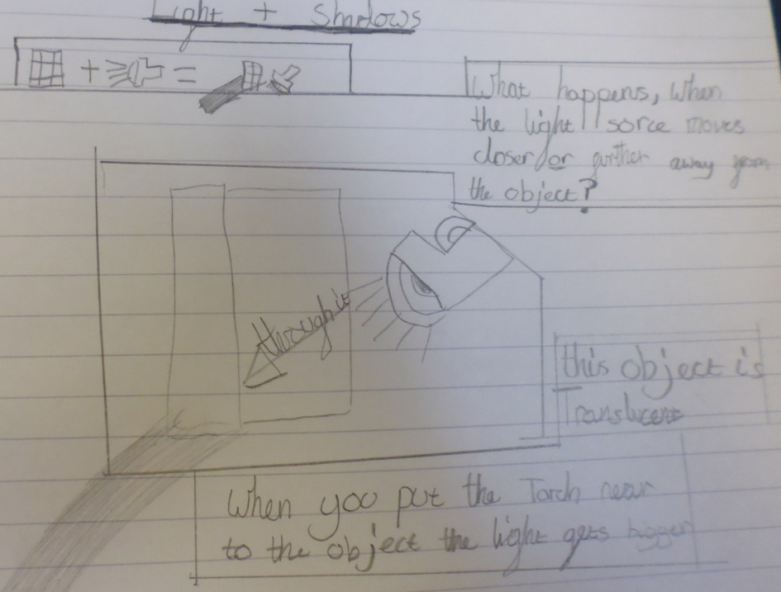
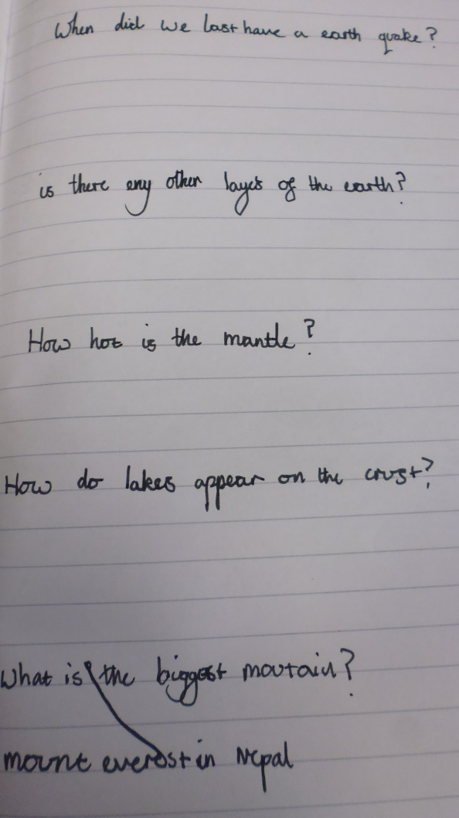
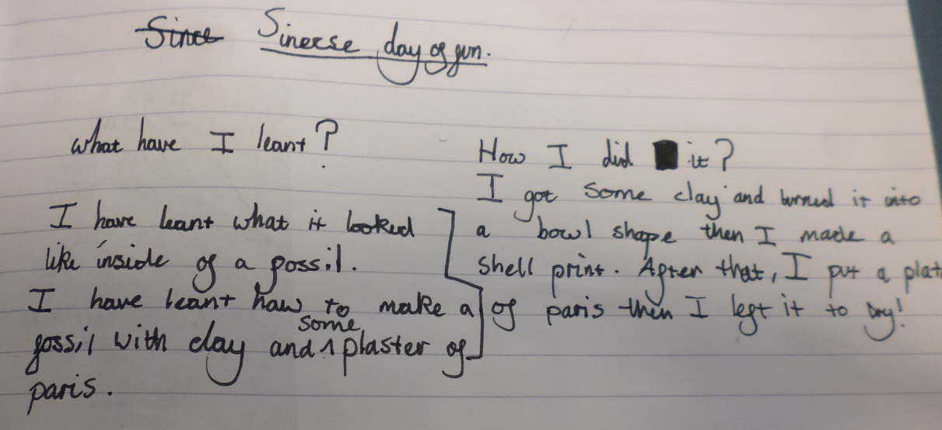
What are we doing in Science?
Scientific Enquiry

Slide 13
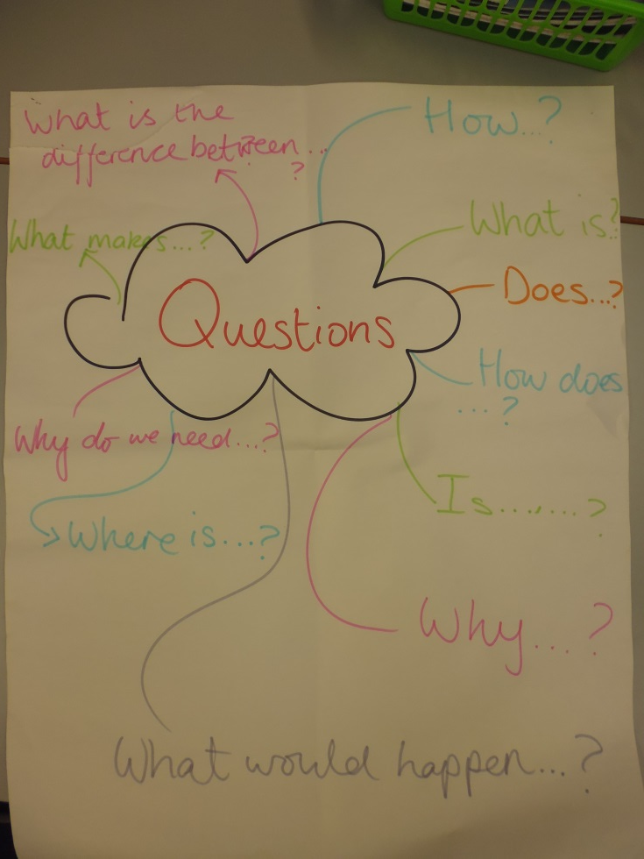
General questioning
The children came up with different ways to ask questions.
This is displayed and the children can access this when they ask questions.

Slide 14
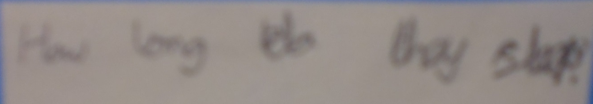
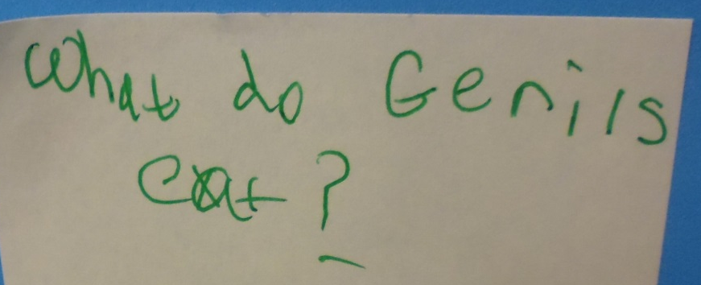
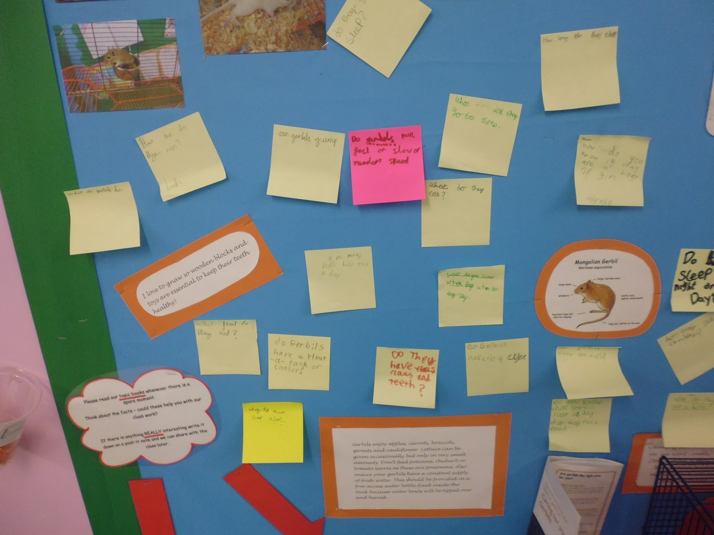
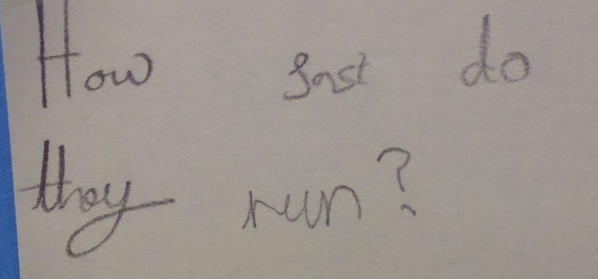
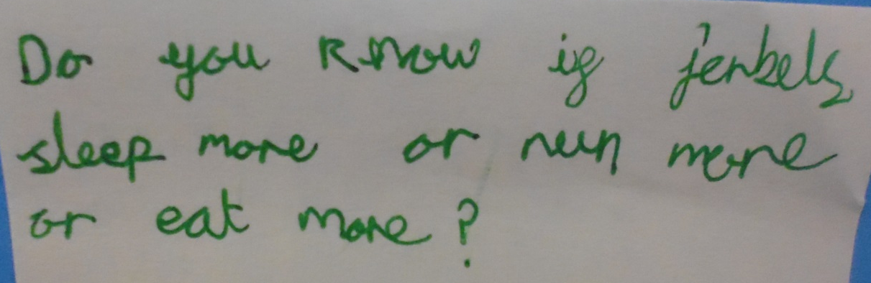

Slide 15
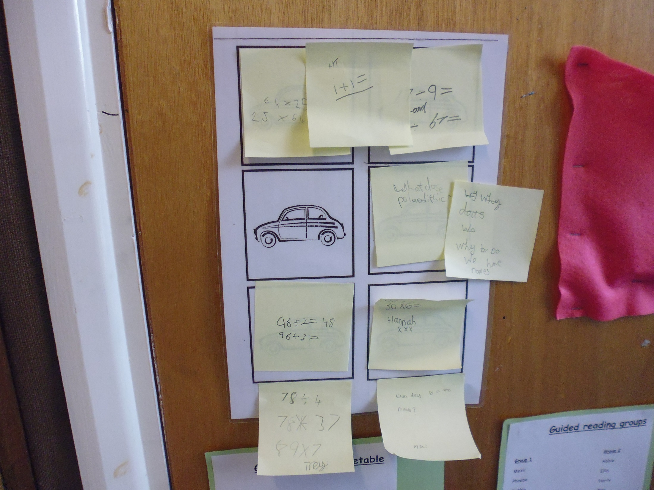

Slide 16
Overall Impact
Using questioning in their work to improve theirs and others writing.
Not being afraid to ask questions and to get things wrong.
Children are more inclined to ask and try to answer questions in all subjects.
Using a wider variety of question starters to pose questions and not just using the most obvious ones.
Children are making links between subjects.

Slide 17
Coming soon… to a classroom near you
What’s working well?
Child centred learning activities
Morning work questions
Integrated questions in learning
Transference of questioning into other subjects
What needs developing / changing?
Talking chips – links to developing listening skills
Giving children more time to respond
Continual differentiation of questions

