Slide 1
How do working walls and resources promote independent learning in Year One?

Slide 2
Pupil Perception Survey- December
We found out that:
children could name the resources that were available in the classroom.
they were unsure of where they could be found and what each resource could be used for.
In response to this we:
put the resources in a central place.
emphasised the resources that would be suitable for the activities during lesson inputs.
discussed how to become an independent learner (circle time).

Slide 3
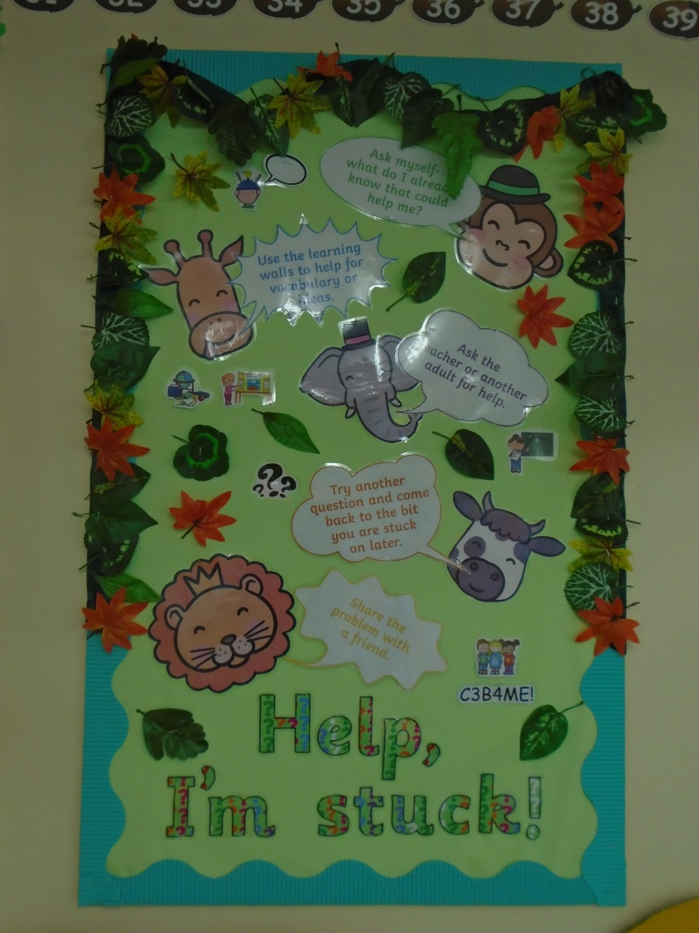
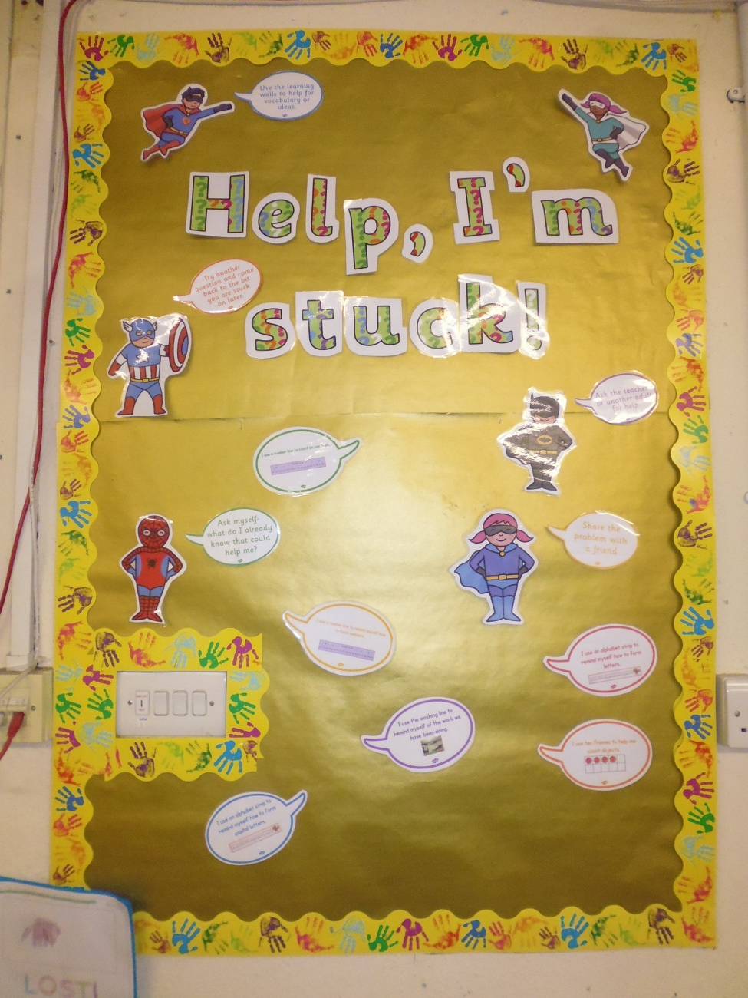

Slide 4
Pupil Perception Survey- January
We found out that:
children could name the resources and were beginning to recall the activities these resources could be used for.
children were beginning to select the appropriate resources independently.
children were better at selecting appropriate resources in Literacy, compared to Numeracy.
In response to this we:
carried on modelling appropriate resources for each lesson.
continued to emphasise how Numeracy resources can be used and for which activity they are best suited.

Slide 5
Pupil Perception Survey- March
We found out that:
most children can select appropriate resources to help them in Literacy and Numeracy and can say how they help them.
all children know where the resources are found.
most children can suggest ways in which they can overcome obstacles, without relying on the teacher for support.
children like using the working walls/washing line for support because they know most things they need to help them are there.
Numeracy- pupils are provided with a range of different methods.
Literacy- spellings of keywords, text maps and grammar reminders.

Slide 6
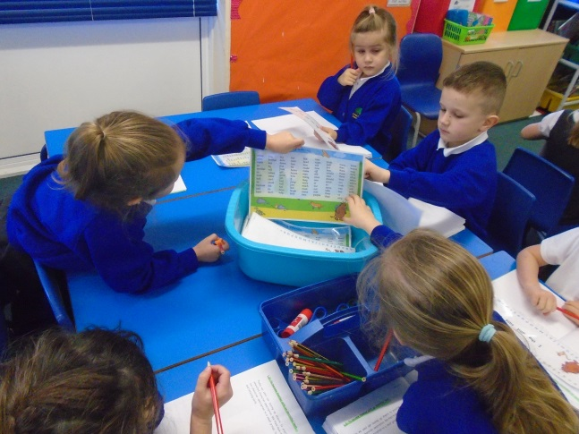
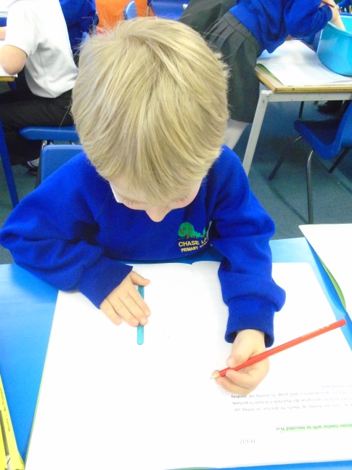
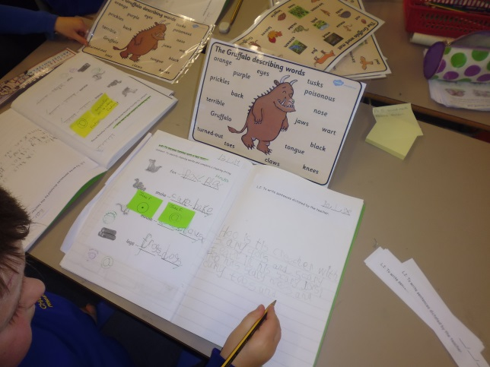
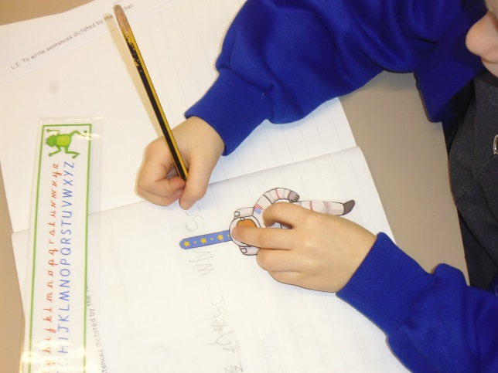
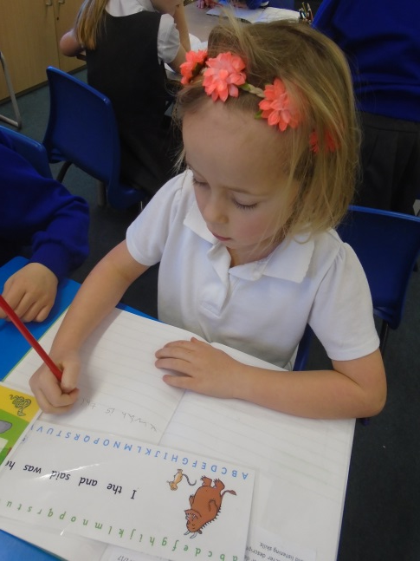
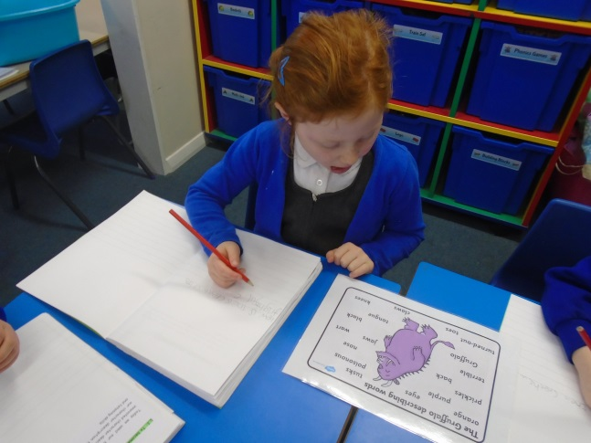
Evidence of resources supporting Literacy

Slide 7
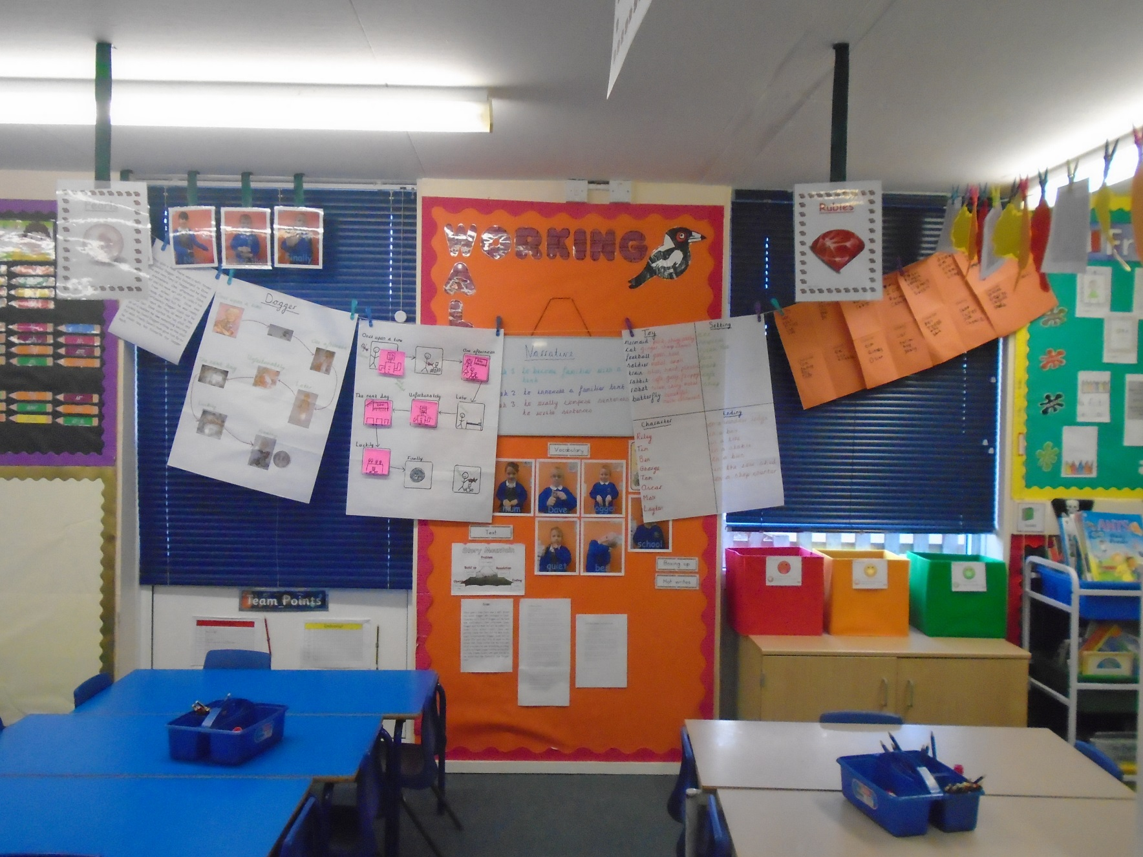

Slide 8
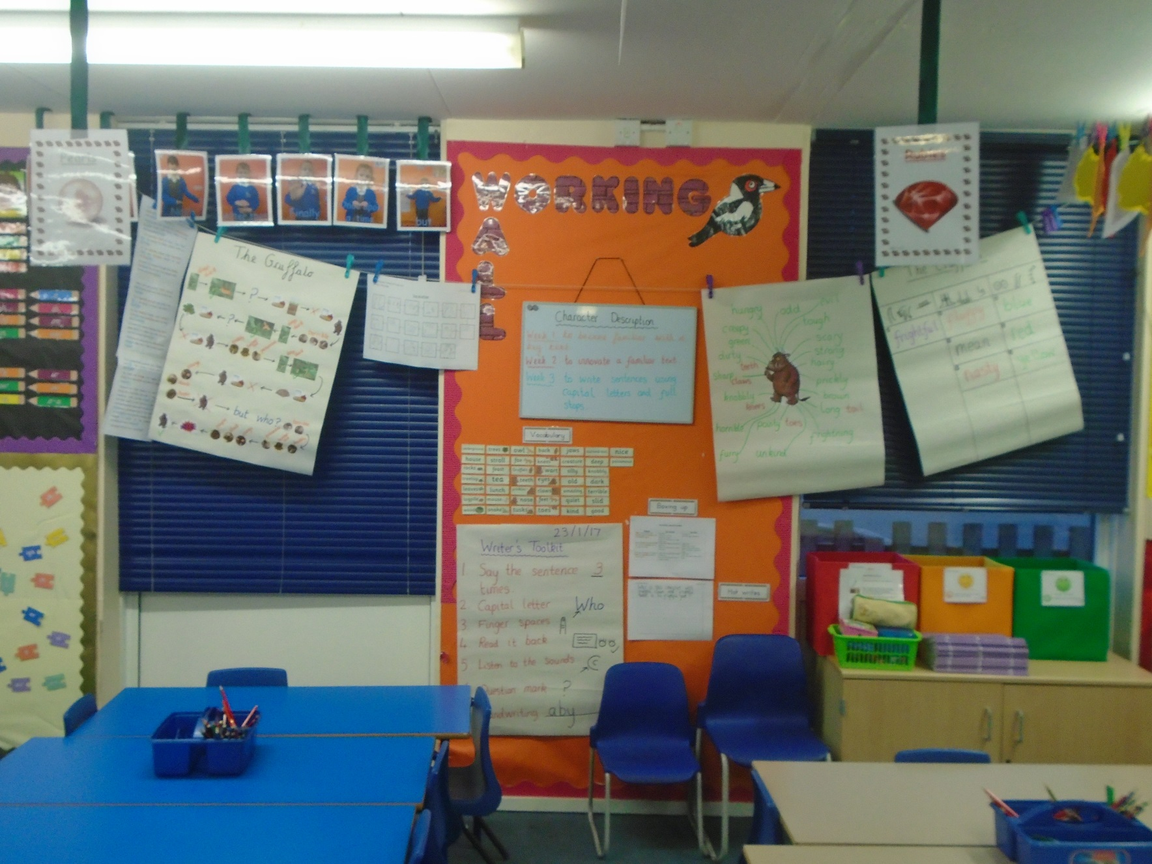

Slide 9
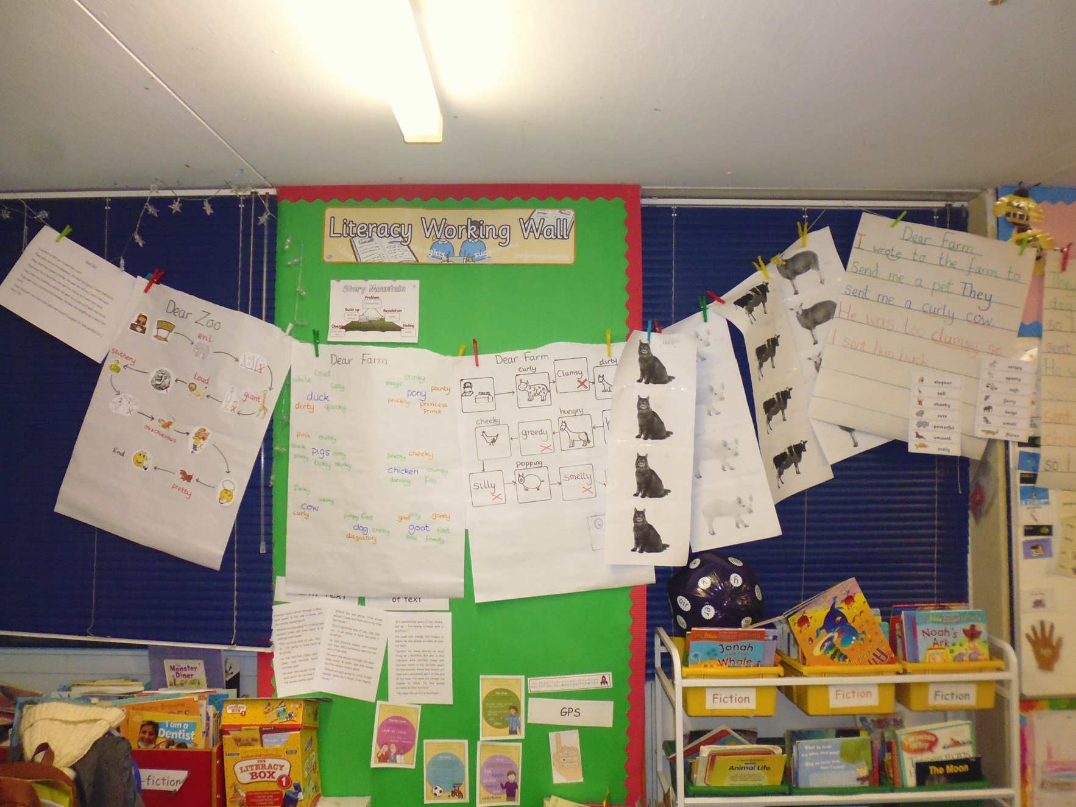

Slide 10
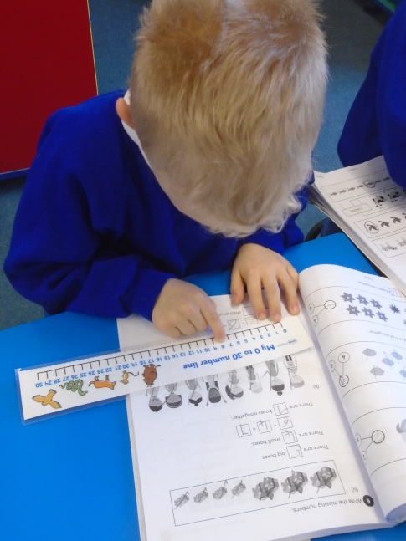
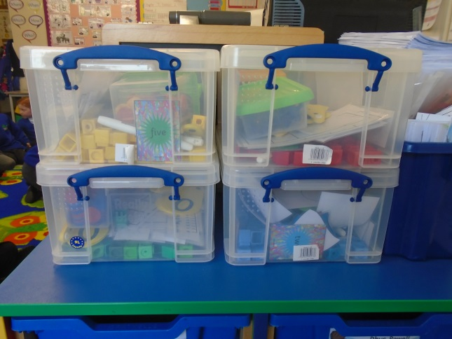
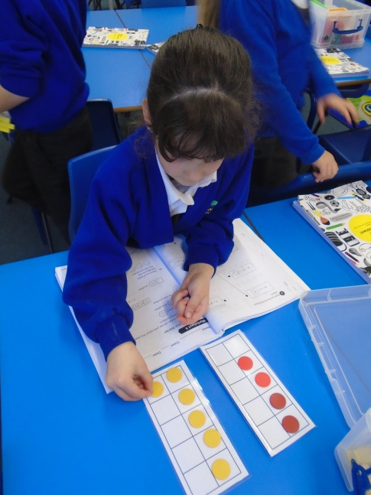
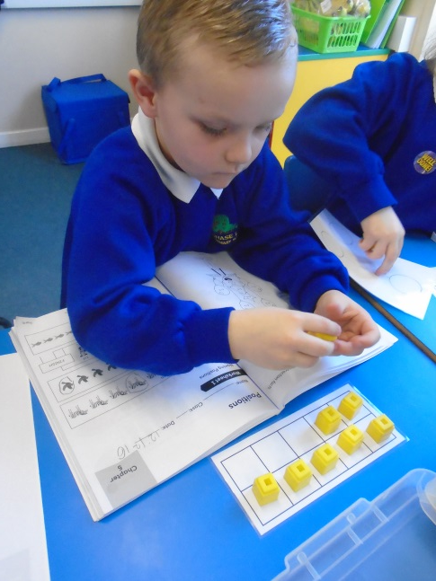
Evidence of resources supporting Numeracy

Slide 11
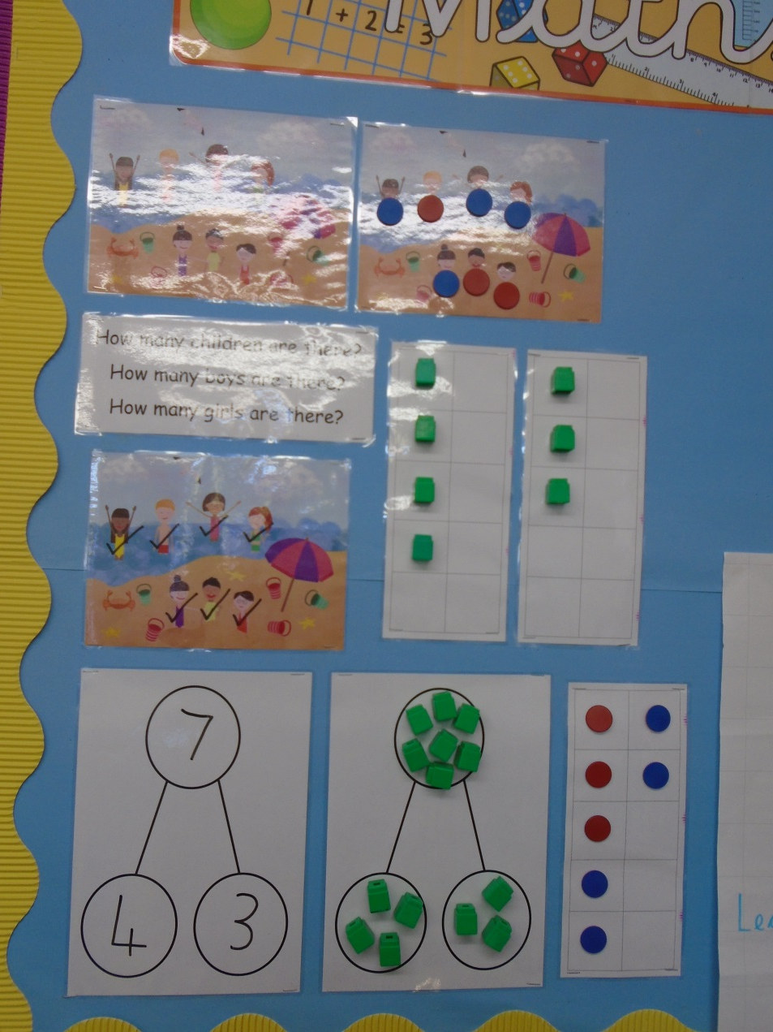

Slide 12
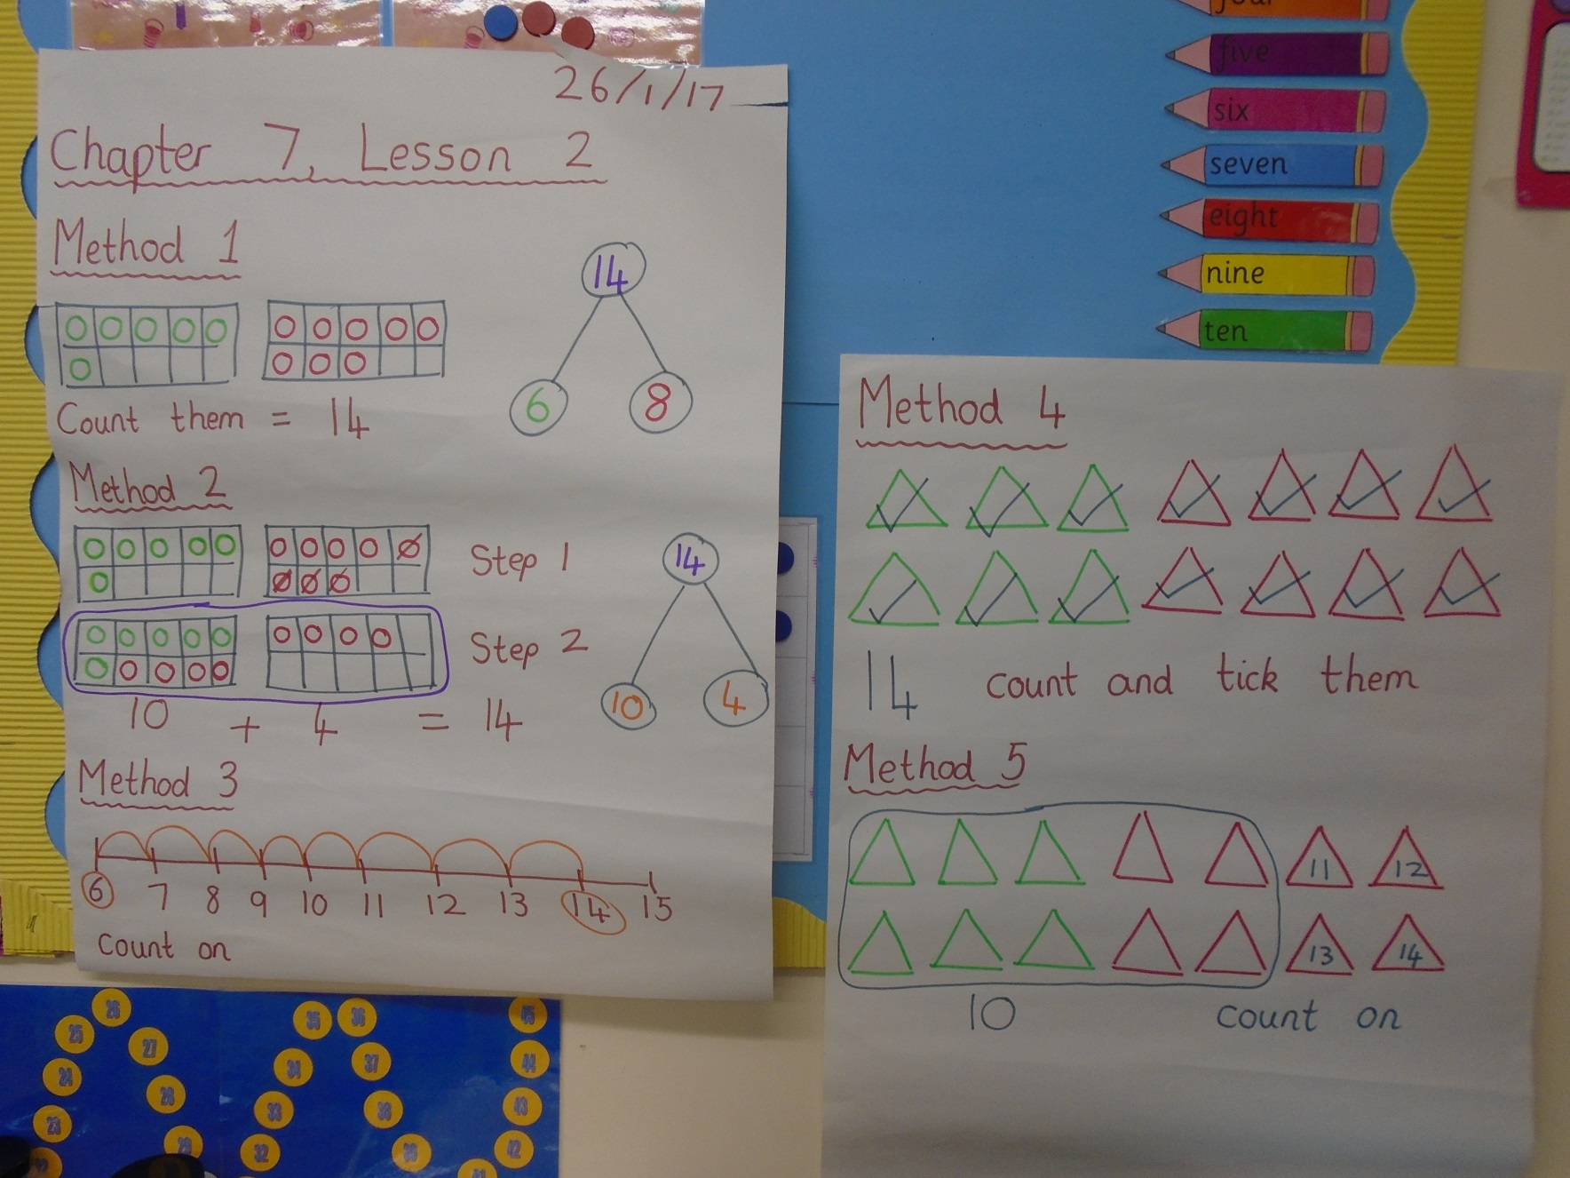

Slide 13
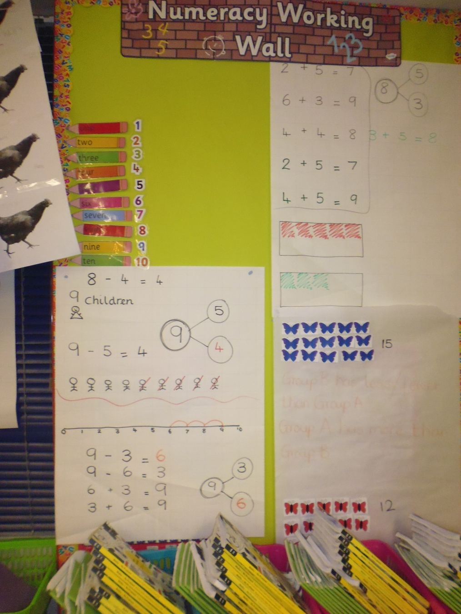

Slide 14
Quotes from children
“I know how to spell jaws. I learnt it from a word mat.”
“I know how to write my numbers properly now. Sometimes I use a number line to help me.”
“The spelling is on the working wall.”
“Tens frames help us with counting.”
“Number lines and tens frames are in the boxes on the tables.”
“I can count on using a number line.”

Slide 15
Conclusion
We know this has worked because:
when marking Literacy books, children are spelling words correctly that are not phonetically decodable.
when marking Numeracy books, number formation has improved as children are using number lines to remind themselves of the correct orientation of numbers.
we see children selecting and using the provided resources without prompting.
children are working collaboratively with their peers and not relying on adult support as much.
we’ve heard conversations between children about the resources they are using to help them.

