Slide 1
Growth Mindset
March 2017
Mrs Peck & Mrs McGowan
Year 2

Slide 2
Areas of focus
To develop positive learners by encouraging them to reflect on how to improve their work

Slide 3
Our actions
Bringing growth mind-set into the classroom
Growth mind-set questionnaire
Respond To Marking (RTM)

Slide 4
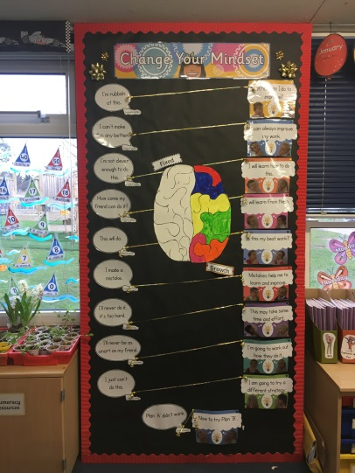
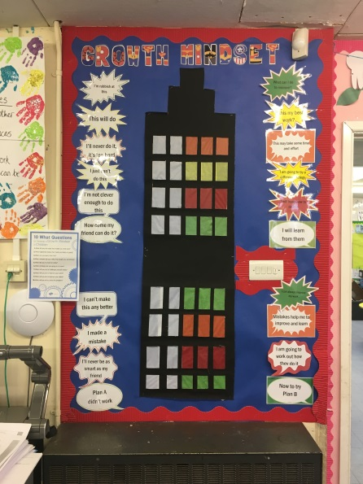
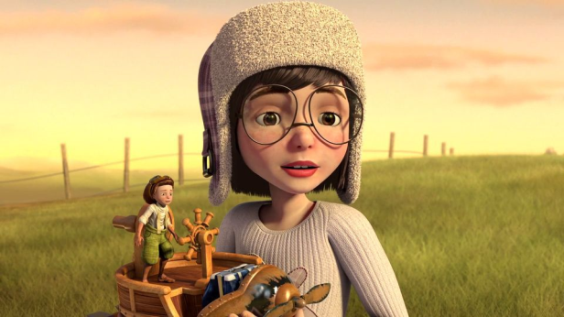
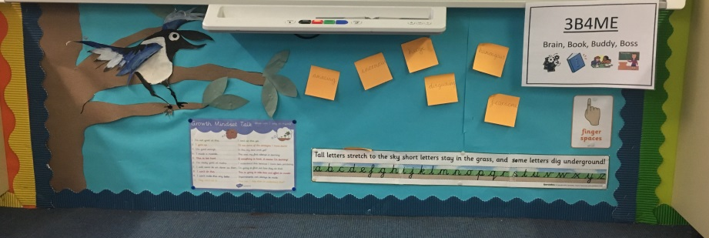
Bringing growth mind-set into the classroom
Actions:
Displays
Circle time
Assembly time
Modelling language
3 b4 me
Outcomes:
Use of growth mind-set language
Display reference
Increased independence
Use of phrases linked to learning behaviours

Slide 5
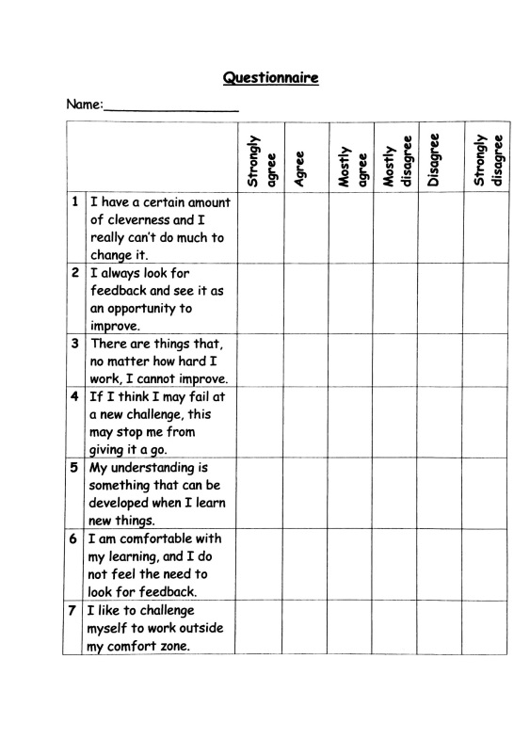
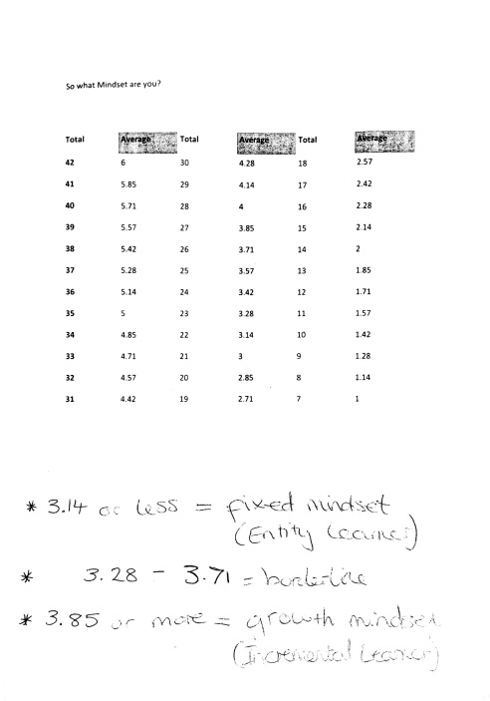
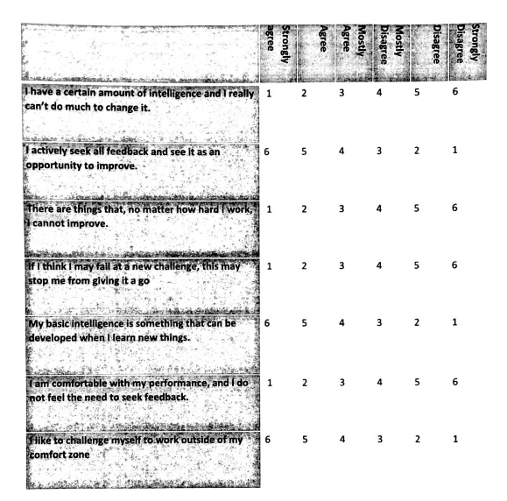
Growth mind-set questionnaire
Actions:
Questionnaire created
Link between Carol Dweck and a school called Beachborough in Northamptonshire
Outcomes:
Children has fixed mind-set
Recognition that children needed to challenge themselves to work outside comfort zone
Seeing feedback as an opportunity to improve

Slide 6
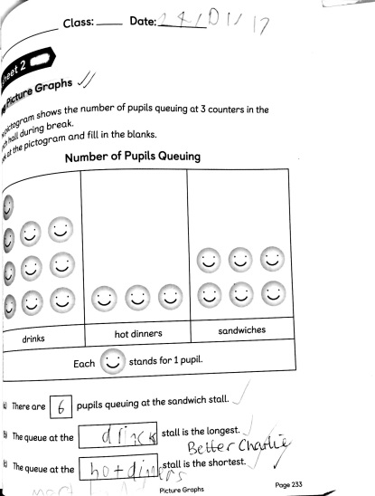
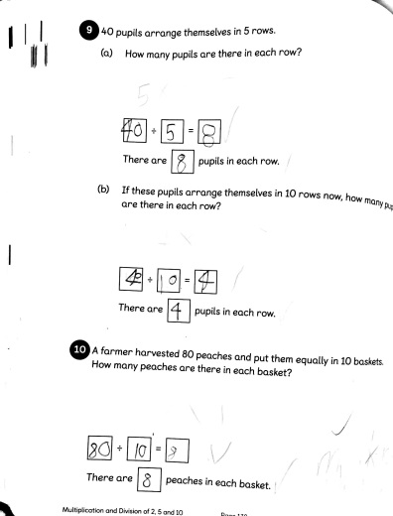
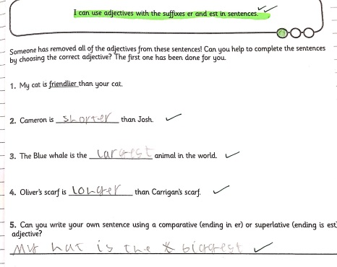
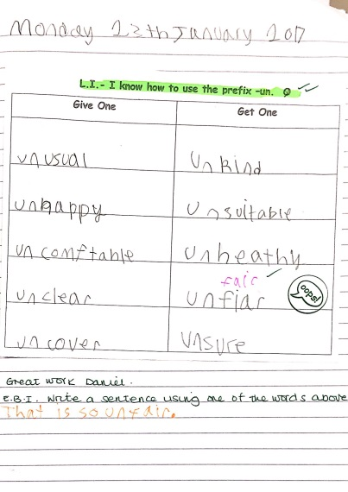
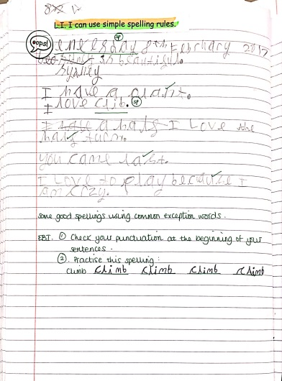
Respond To Marking (RTM)
Actions:
Mini lessons on RTM
Taking out small groups who are not responding to marking
Applied RTM in literacy and numeracy
Outcomes:
Dedicated time for children not responding
More time for children to respond to marking
Greater opportunities to mark self and peers

