Slide 1
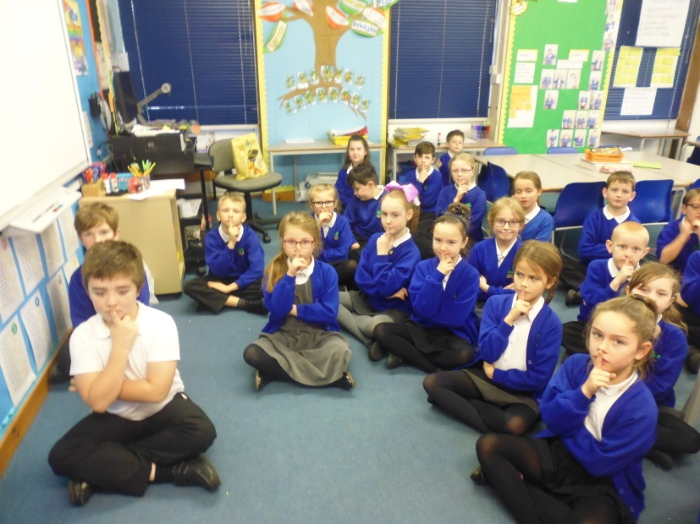
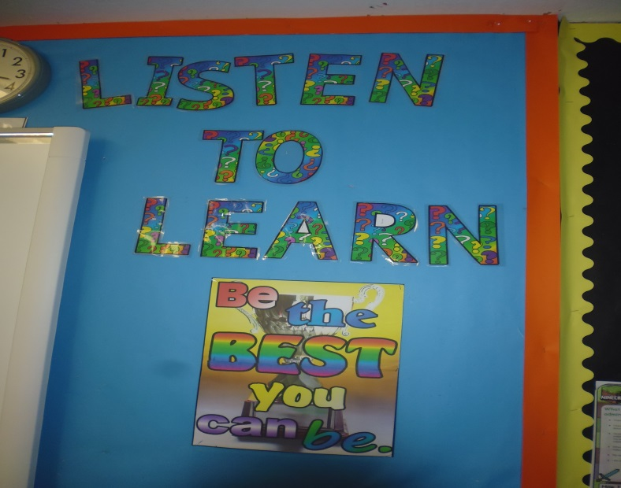
Learn to Listen: Listen to Learn
Enabling children to become self-regulating, independent learners
Mrs Dace – Spring Term 2017

Slide 2
Learn to Listen: Listen to Learn

Slide 3
Learn to Listen: Listen to Learn

Slide 4
Learn to Listen: Listen to Learn

Slide 5
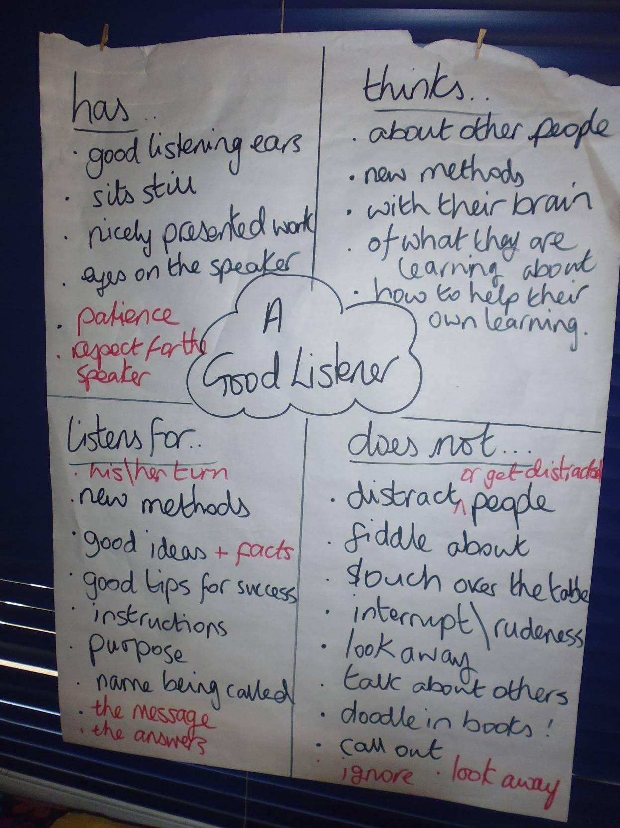

Slide 6
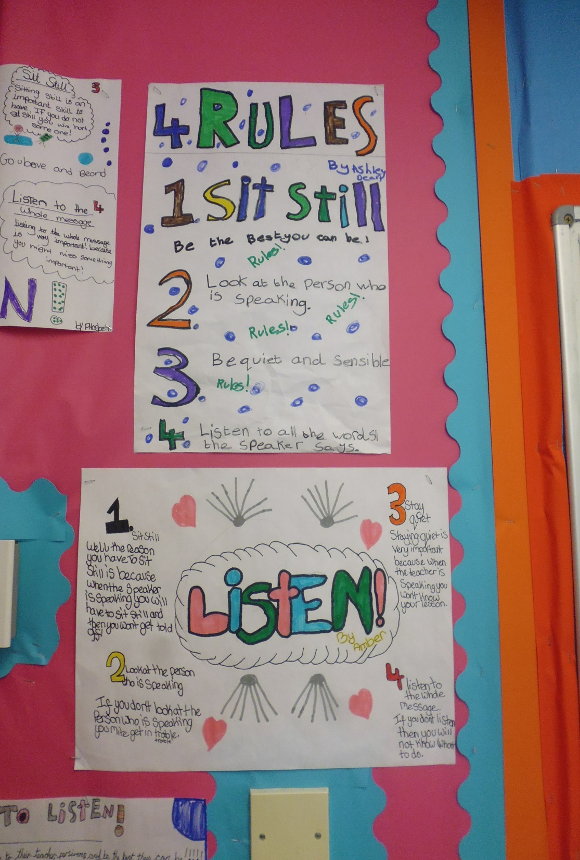
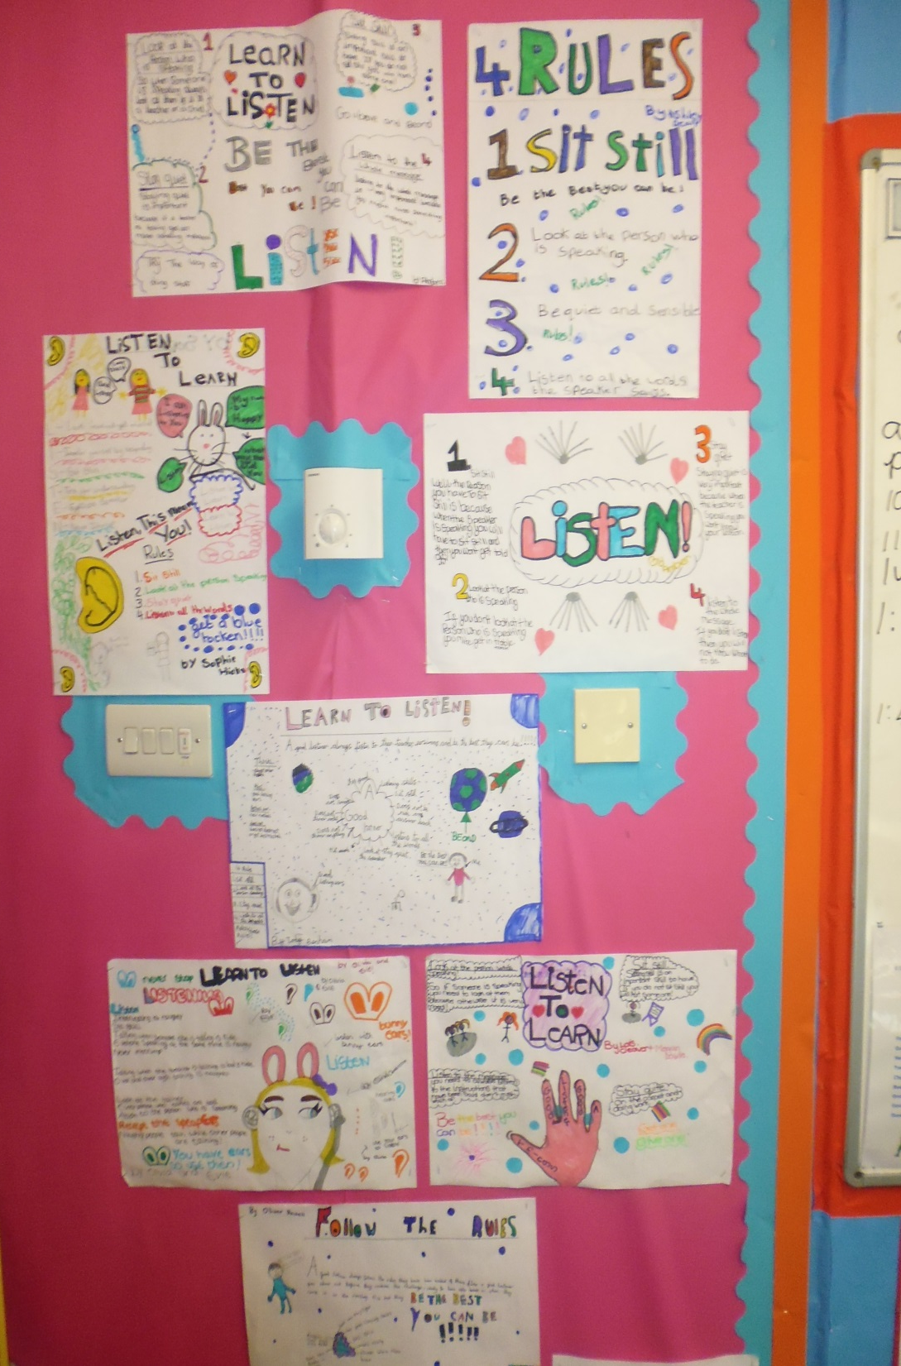

Slide 7
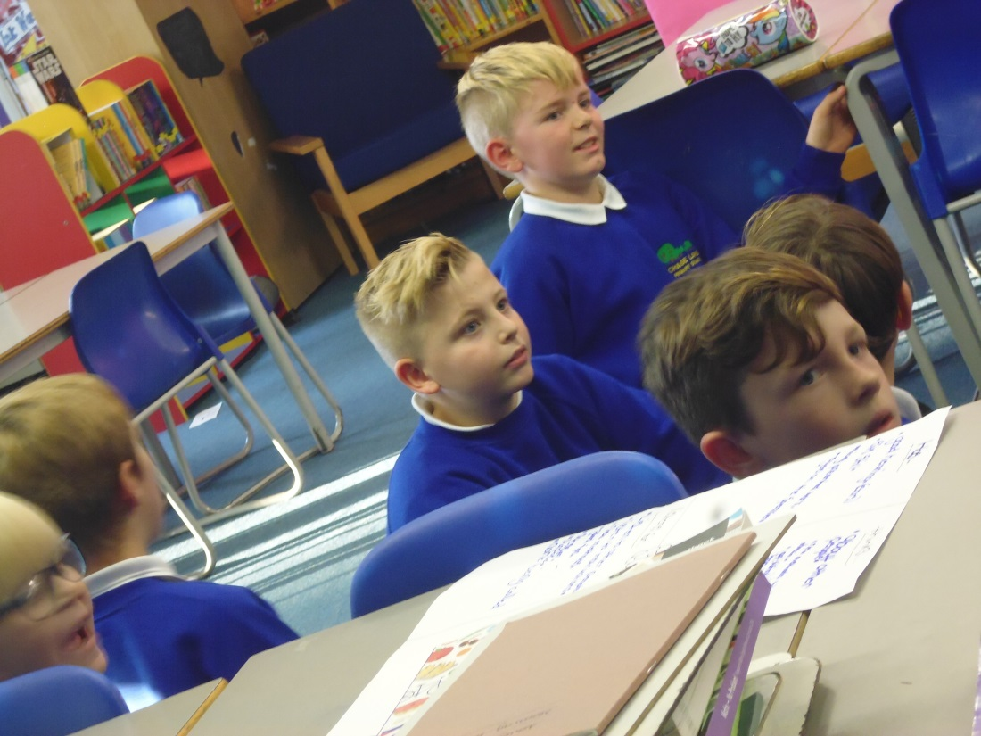
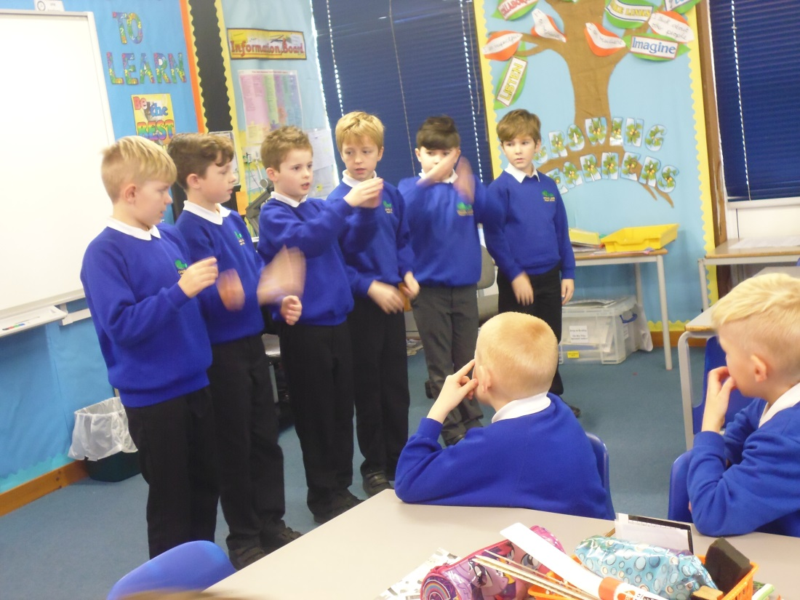
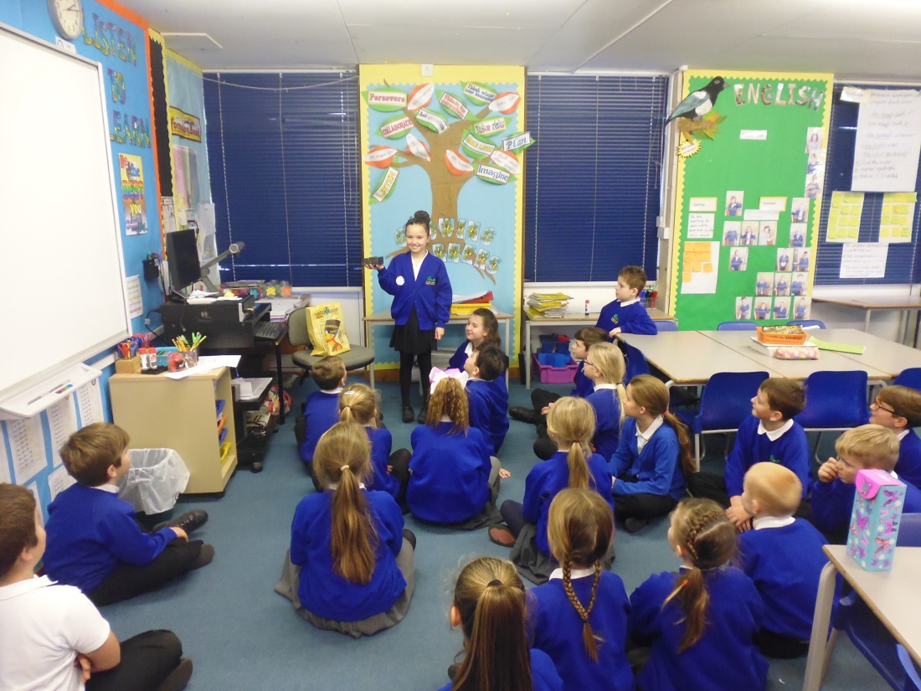
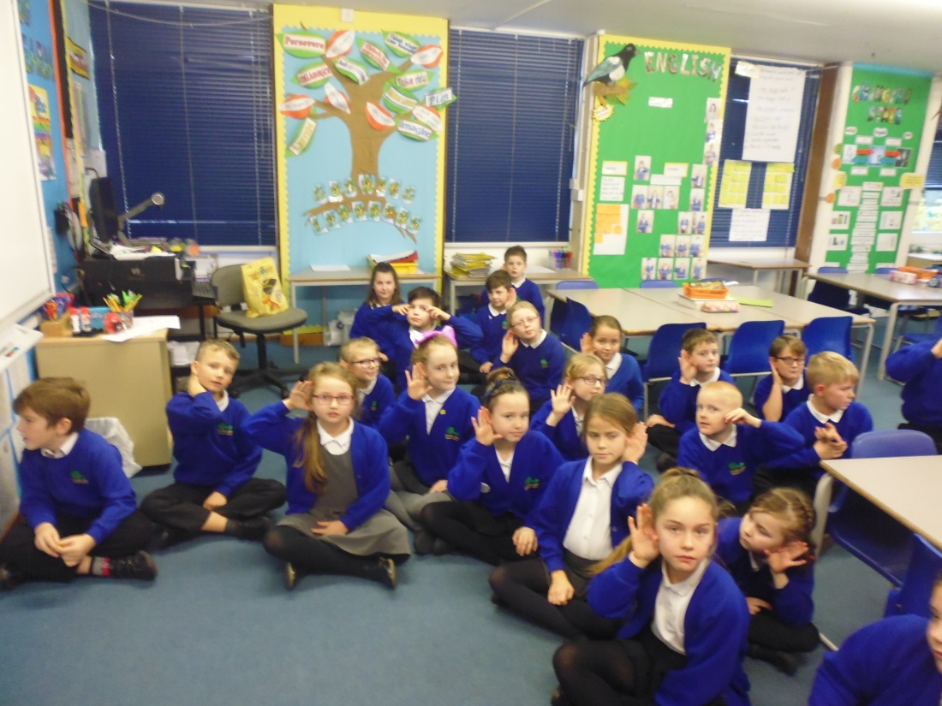
……after Listening Activities

Slide 8
How carefully were you listening?
What are the four rules for good listening?

