Slide 1
Year 5 Project
By Mr Baxter and Miss Archer

Slide 2
Our Focus
Our initial focus was on developing independent and focused learners
However we realised that in order to achieve this we also had to develop collaborative learning skills

Slide 3
Year 5 before we started
First thought - ‘Miss Miss’
Lacked the desire for a challenge
Reluctant to ask others for support
Fear of failure
Unaware of learning behaviours

Slide 4
What we did
3 Before Me
Talk partners
Chilli Challenges
What makes a good learner?
Brain breaks

Slide 5
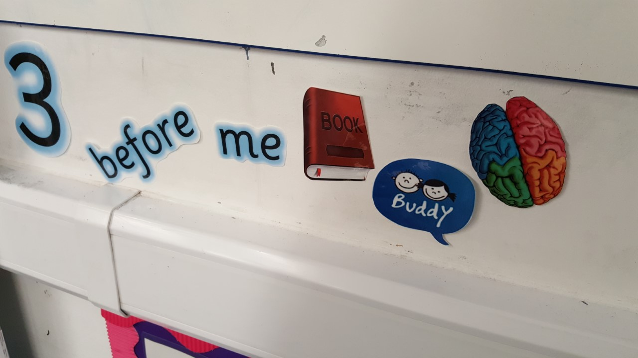
3 Before Me

Slide 6
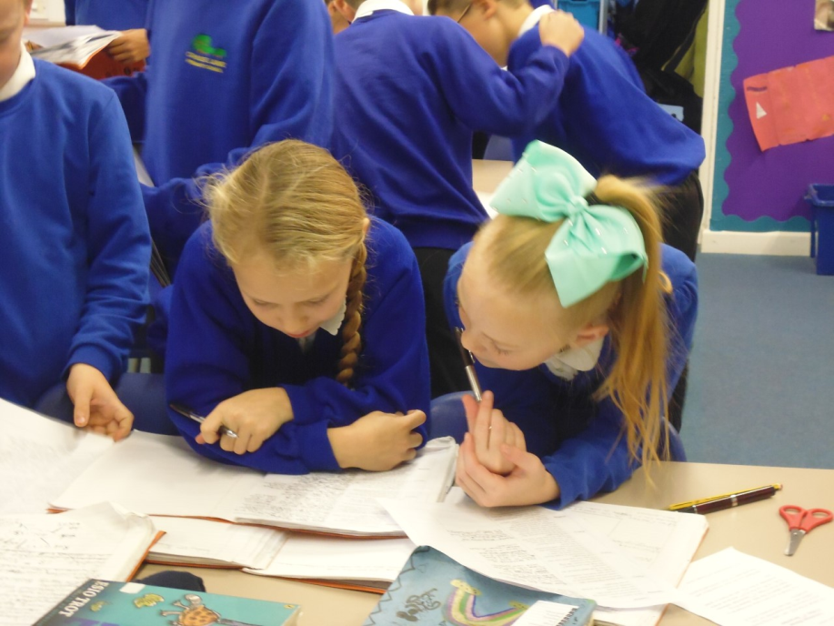
3 Before Me
Aim to develop
independent
learners
What is it?
What did we have to do?
How has it developed the children’s independence?

Slide 7
Children’s thoughts
What tools do you use in the classroom to help you to work independently?
Jason – 3 Before Mr Baxter – We have to ask everyone on our table for help before we can ask Mr Baxter for help.
Kira – I always ask my partner or look at the board/display to help me before I ask Mr Baxter for help. Sometimes my friend helps me get to the answer so I don’t even have to ask Mr Baxter.
Robert – I like that we can use our writing journals to practise our skills when we need to… like a note book. We also use 3 Before Me (book, buddy, brain) so I find other people to ask for help instead of an adult.

Slide 8
Children’s thoughts
What tools do you use in the classroom to help you to work independently?
Chloe – I like to use the resources and the working walls. Sometimes Miss Archer has to remind us to use these things but I think, generally, we’re getting better.
Emily – I try to use 3 Before Me as much as possible. Before I would always ask the teacher and now I choose someone else first.
What can you do if you are stuck on something in your work?
Hayy – I ask a friend to help me. That’s part of 3 Before Me.
Alfie – I always ask someone on my table first. I used to go up to the teacher all the time but now I use the people on my table for ideas.

Slide 9
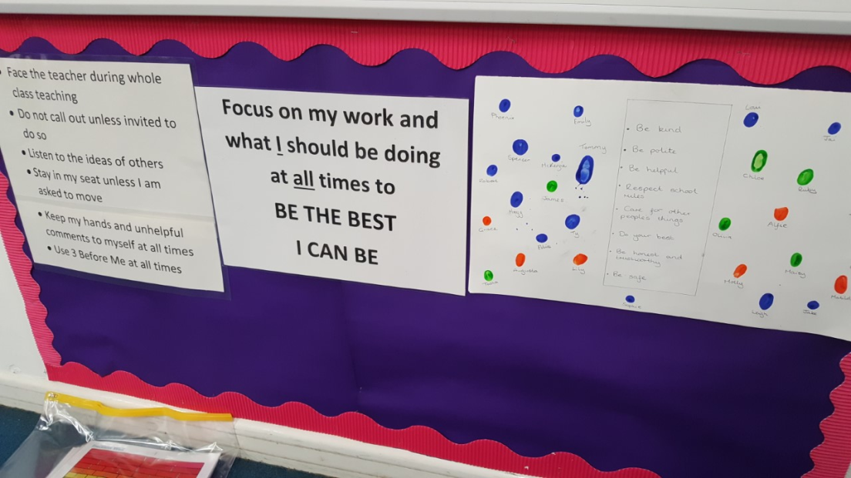
What makes a good learner?
Aim to establish learning behaviours and to provide children with a reference point.
What we did?
What impact has it had?

Slide 10
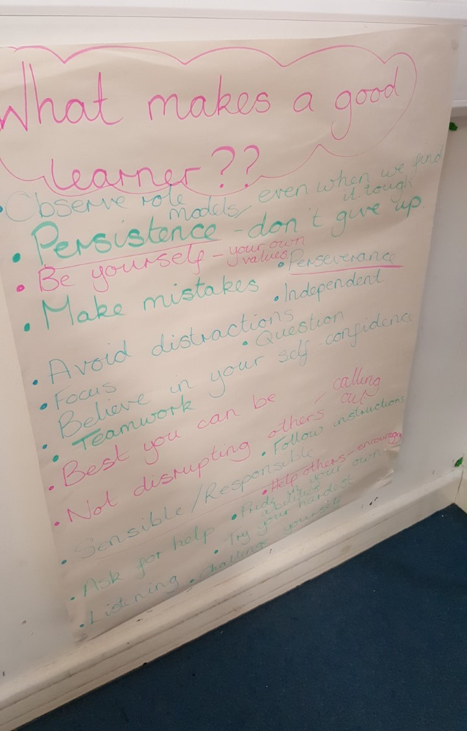
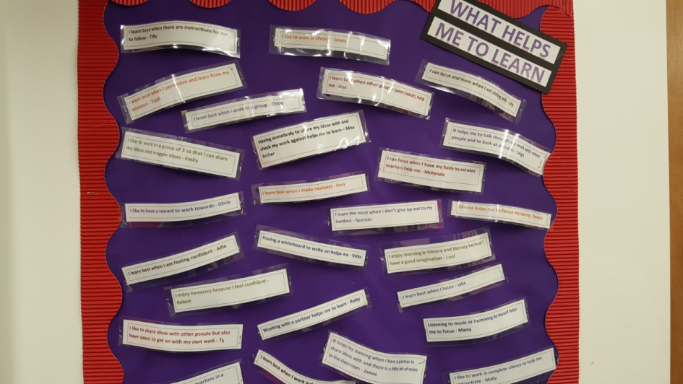
What makes a good learner?

Slide 11
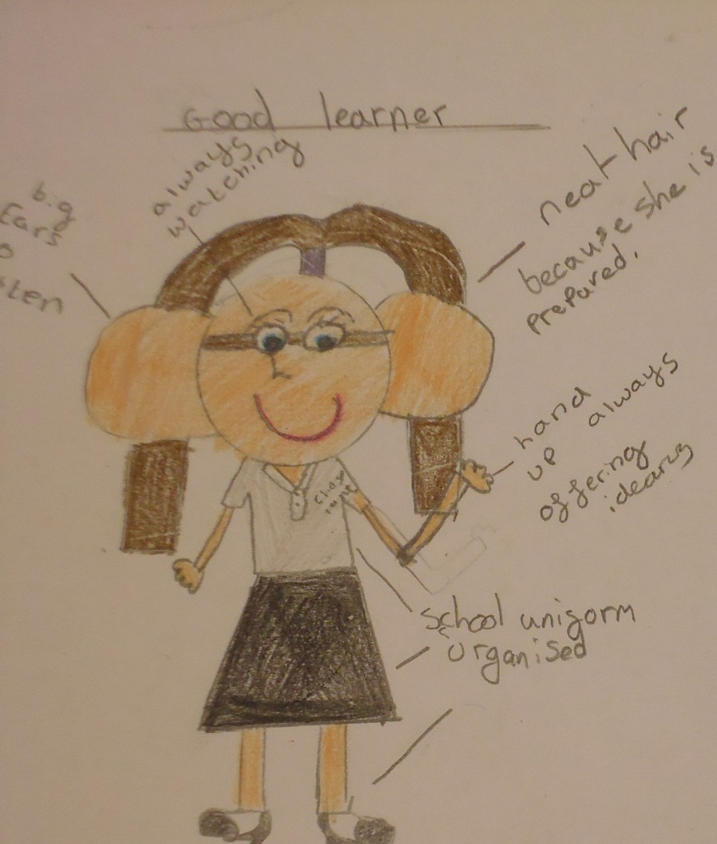
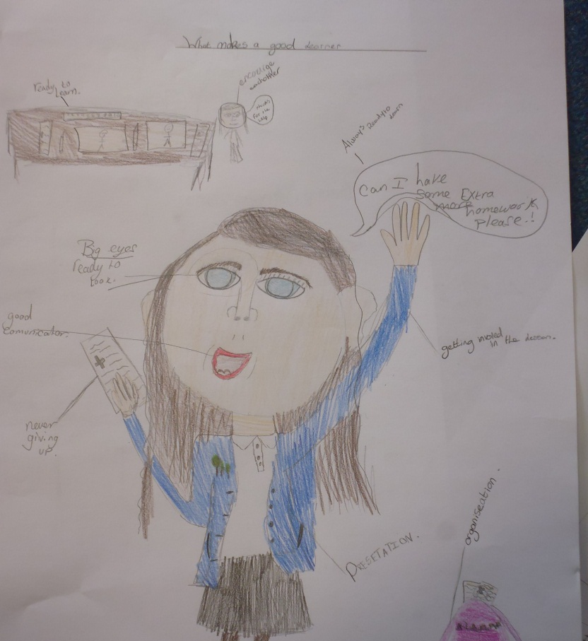


Slide 12
Children’s thoughts
How has your attitude changed towards your learning since being in Year 5?
Maisy – I used to get really upset last year because I didn’t have much resilience but I feel like I have built up my confidence this year. I feel much more independent with my learning because I have tactics to help me learn on my own. I think my mindset has changed.
Chloe – I am really challenging myself this year and pushing myself out of my comfort zone. I didn’t think I’d ever choose a hot chilli challenge but I’ve started to do that now to challenge myself.
Emily – I think I’m making better choices about my own learning. Instead of asking the teacher for help all the time I’m now starting to think about things for myself and find resources around the classroom to help me.

Slide 13
Children’s thoughts
How do you learn best? What helps you to learn?
Maisy – I like to have a bit of sound such as music or talking and I like to be able to share my ideas.
Robert – I like it to be quiet and to work independently. I also prefer being active and away from the chairs and tables in the classroom.
Tilly – I like to have clear instructions and then the chance to discuss my work with a partner or people on my table.
Phoenix – I like to have quiet so that I can focus on working independently.

Slide 14
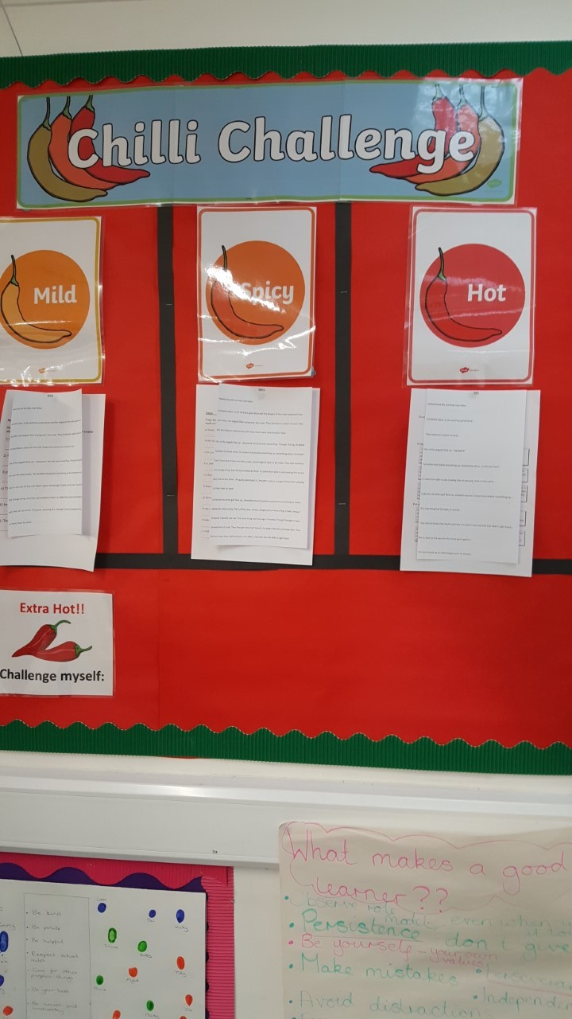
Chilli Challenges
Aim to develop
independent
learners and
children that are aware
of their learning.
What is it?
What did we have to do?

Slide 15
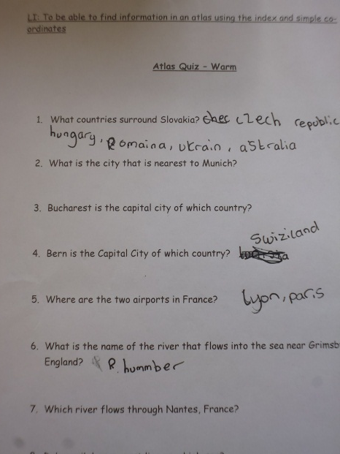
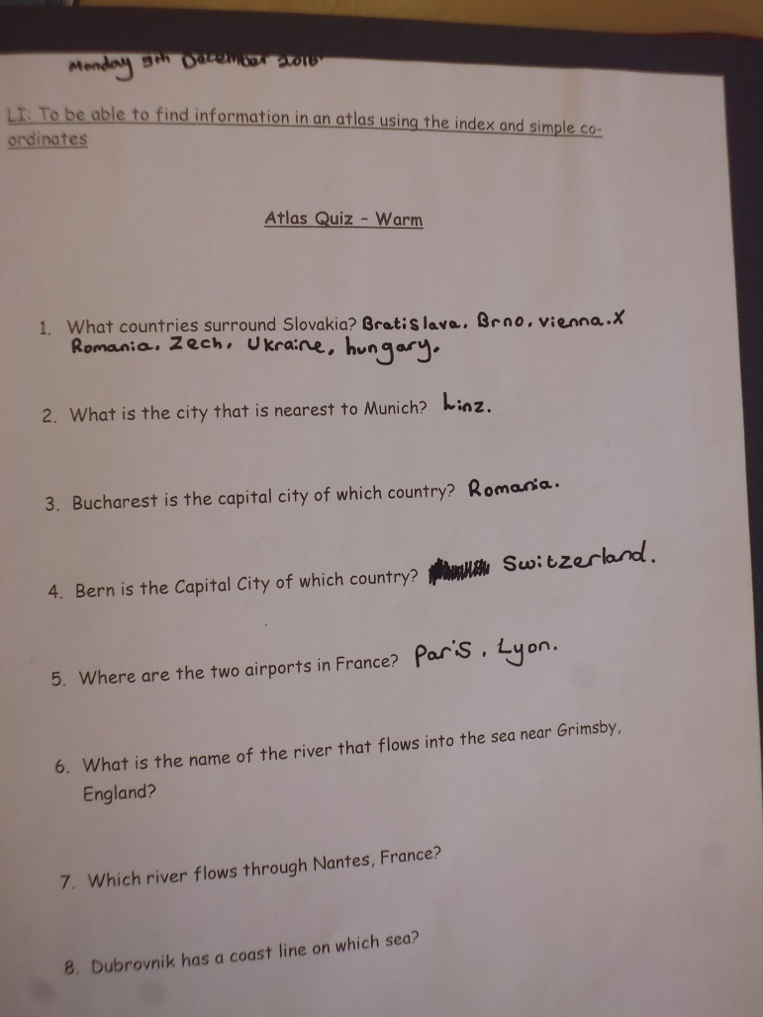
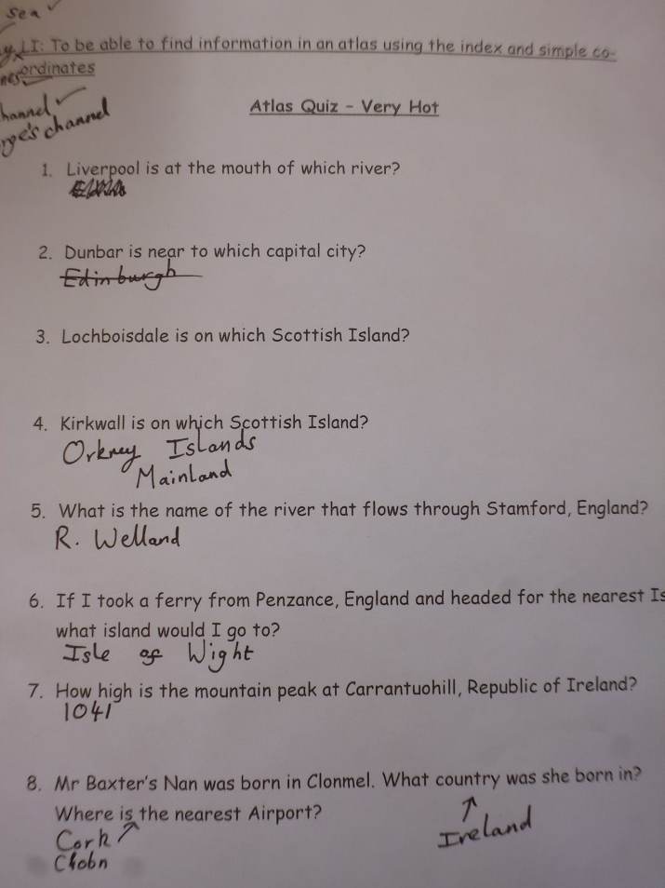
Chilli Challenges

Slide 16
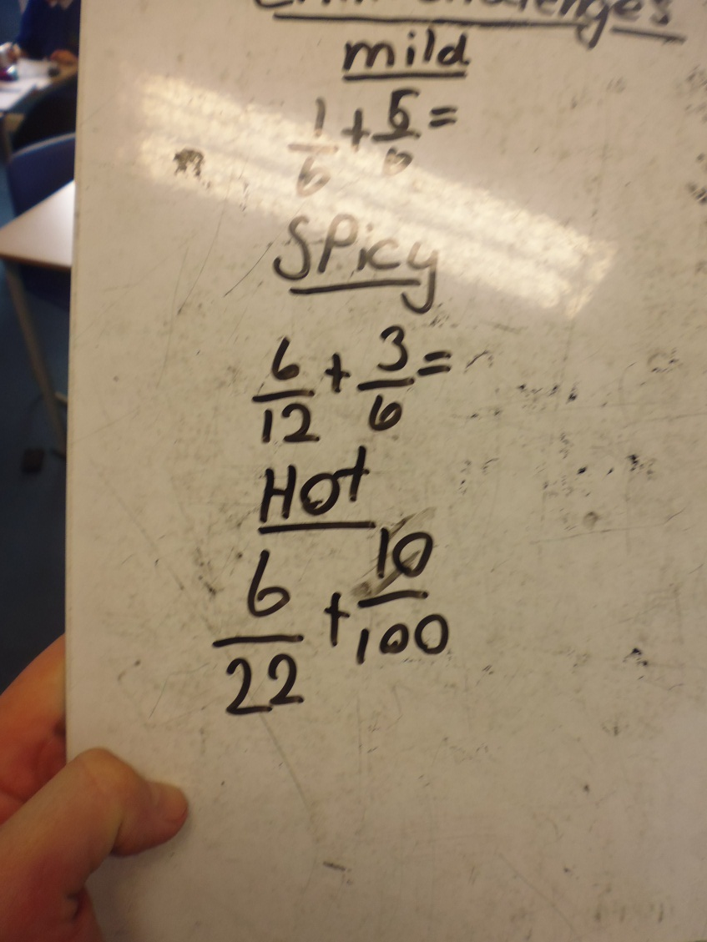
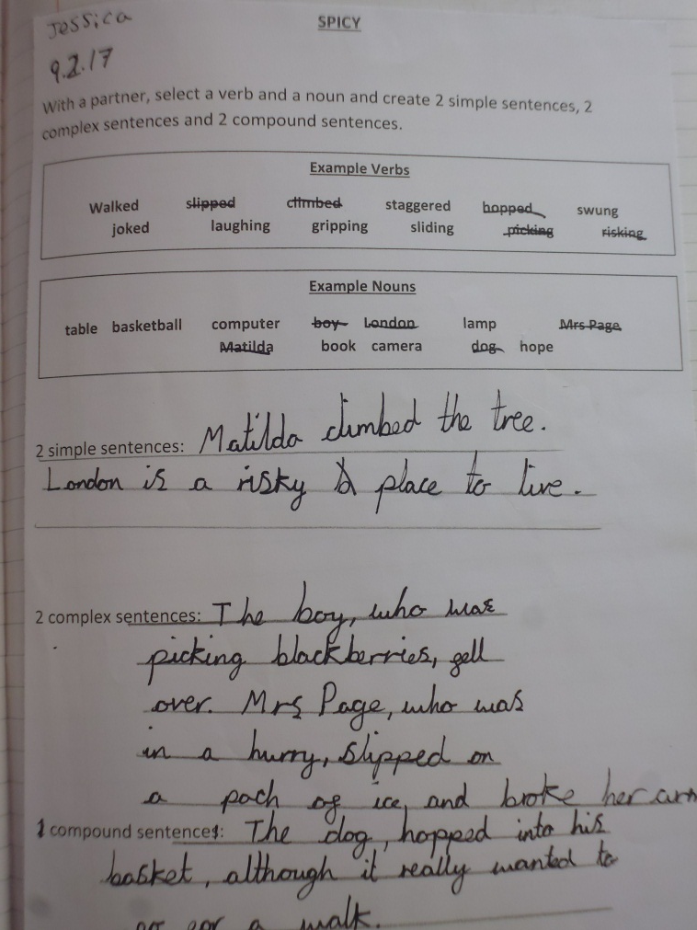
Chilli Challenges

Slide 17
Children’s thoughts
What do you like/dislike about the chilli challenges?
Kira – I like that you can choose your own challenge if you’re not sure of what you’re meant to be doing. I also like that you don’t always HAVE to do the hardest challenge.
Jason – I like that I can push myself and practise a skill that I’m not 100% sure of. Then I can move myself on when I finish.
Lily H – If you’re unsure about what you’re doing then you can start on quite a mild challenge and then if, half way through, you start to understand you can move on. You don’t need to finish the whole of one task if you’re finding it too easy or too hard.
Oliver E – I like that the challenges suit anyone in the class. If you really understand something then you can go straight into a hot challenge. If you don’t understand then you can start on something a bit more mild

Slide 18
Children’s thoughts
What do you like/dislike about the chilli challenges?
Tilly – I like that I can challenge myself so I always want to start on a spicy or hot challenge. Sometimes the mild challenge would be the best but I don’t want to say that I’m doing the mild challenge because people might think that’s too easy.
Phoenix – I really like choosing my own challenge. Sometimes all the challenges are a bit tricky, even the mild, so maybe we could have an extra mild challenge.
Robert – I get a sense of achievement if I try the hot challenge and I get it right. I feel like I’ve really challenged myself. I don’t like choosing the mild challenge because I think it should be for people that don’t understand. I want to always try the harder challenge!
Maisy – I really like the challenges. It’s good to be able to choose some different work from the other people on my table or my partner. Sometimes I find the hot too comfortable so I’m not pushing myself. I’d like to have some extension activities beyond extra hot so that I can help other people.

Slide 19
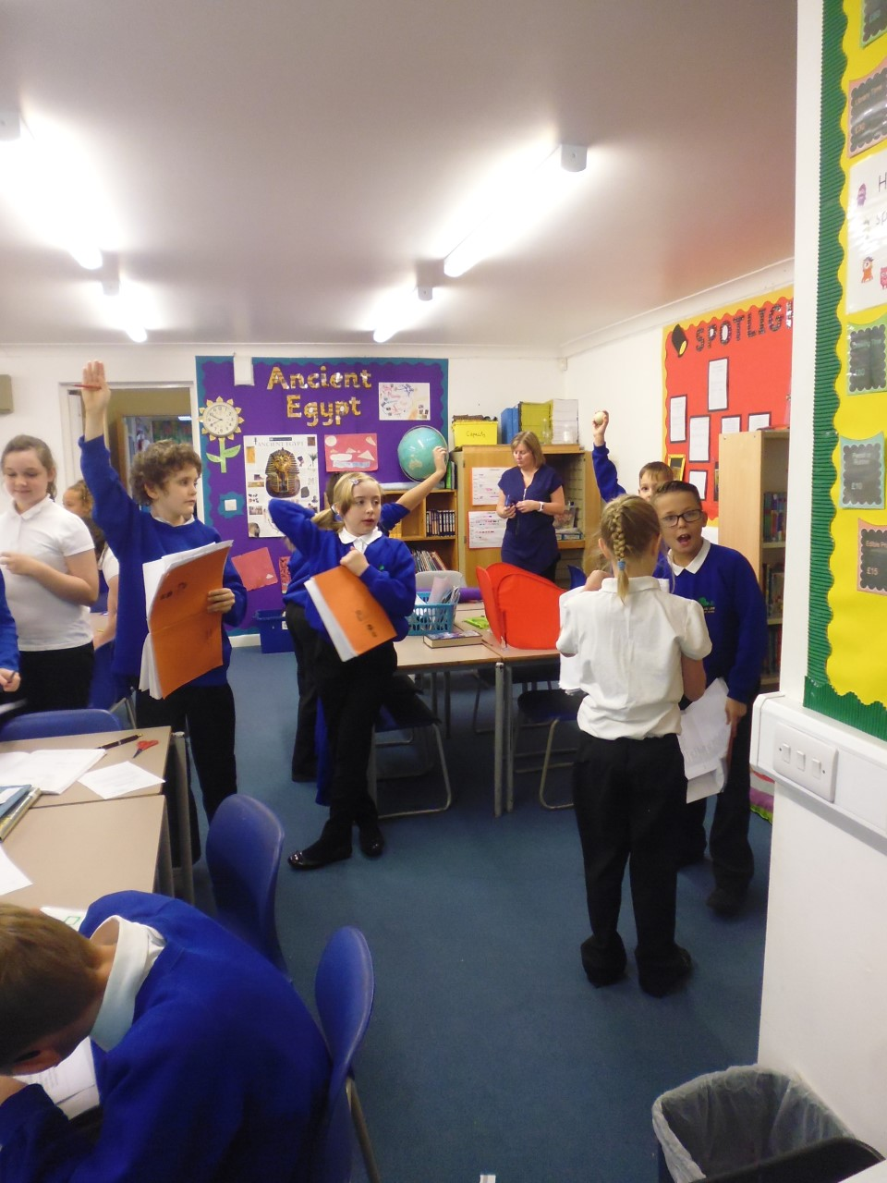
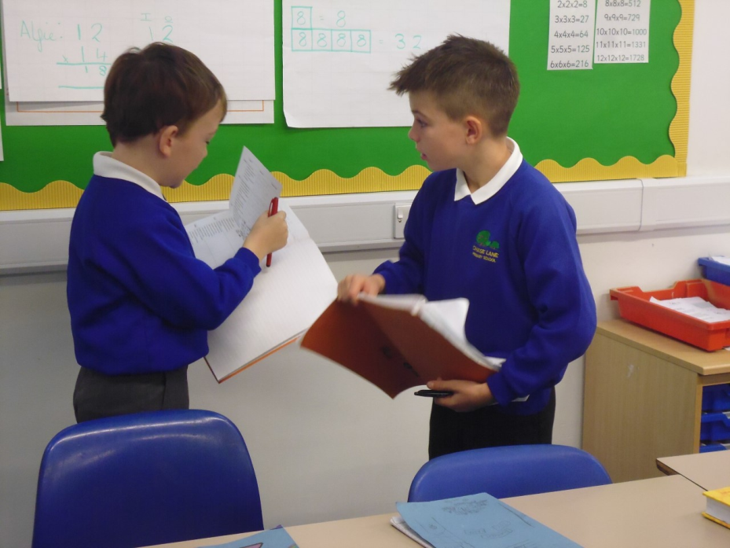
Active learning – Give one Get one Hand up, Pair up, Share up

Slide 20
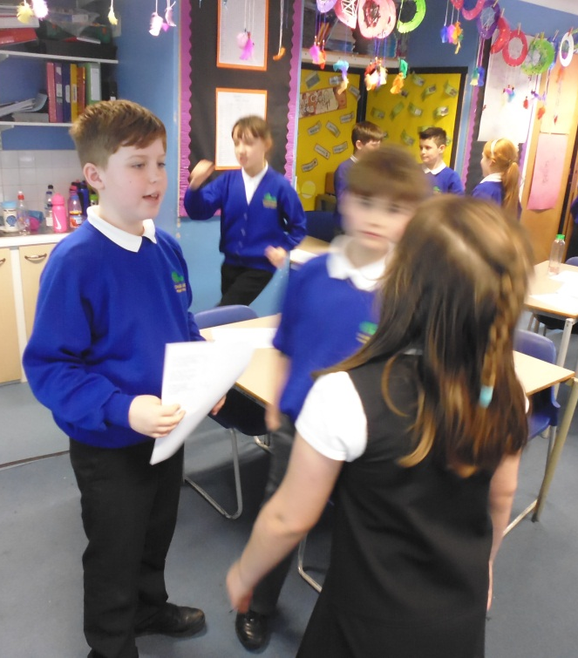
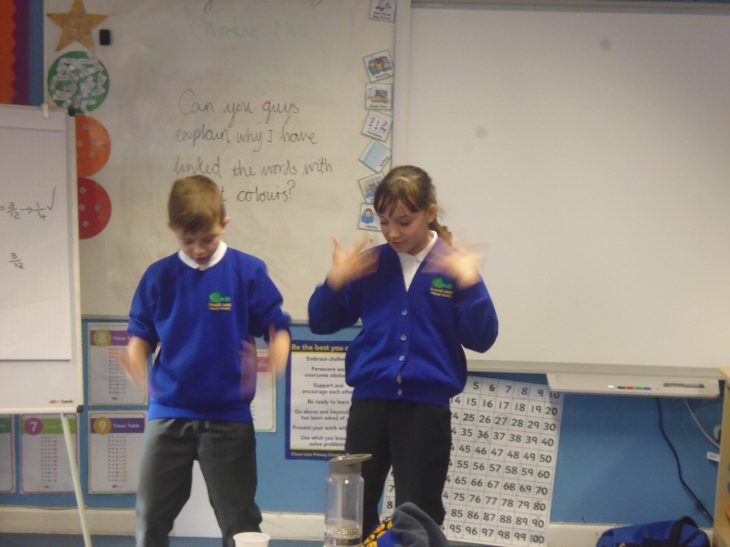
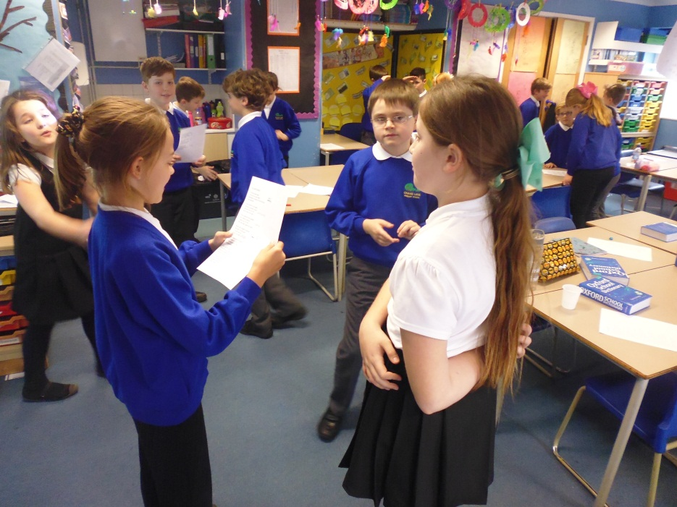
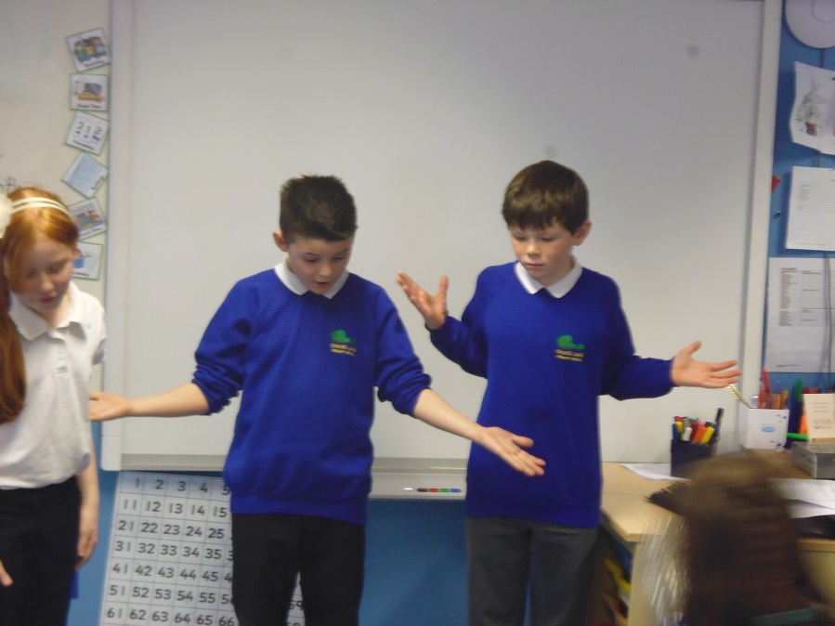
Active learning –

Slide 21
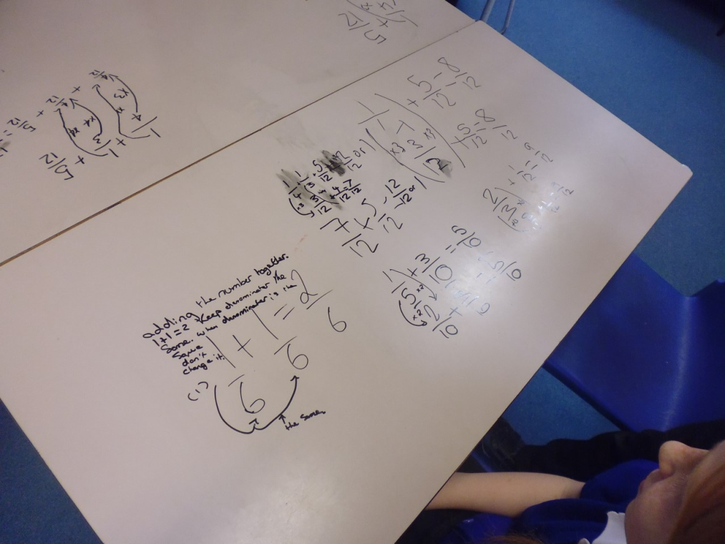
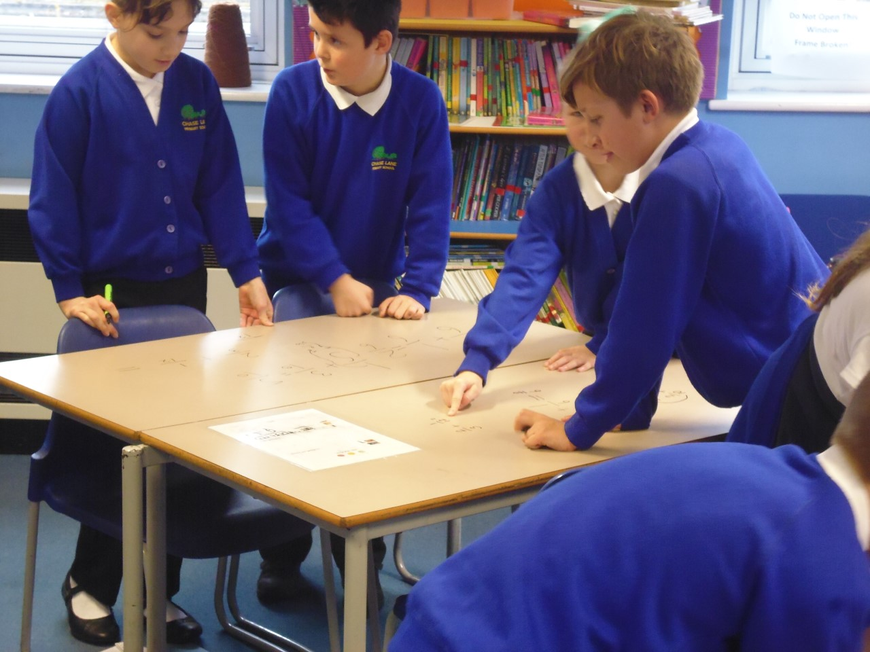
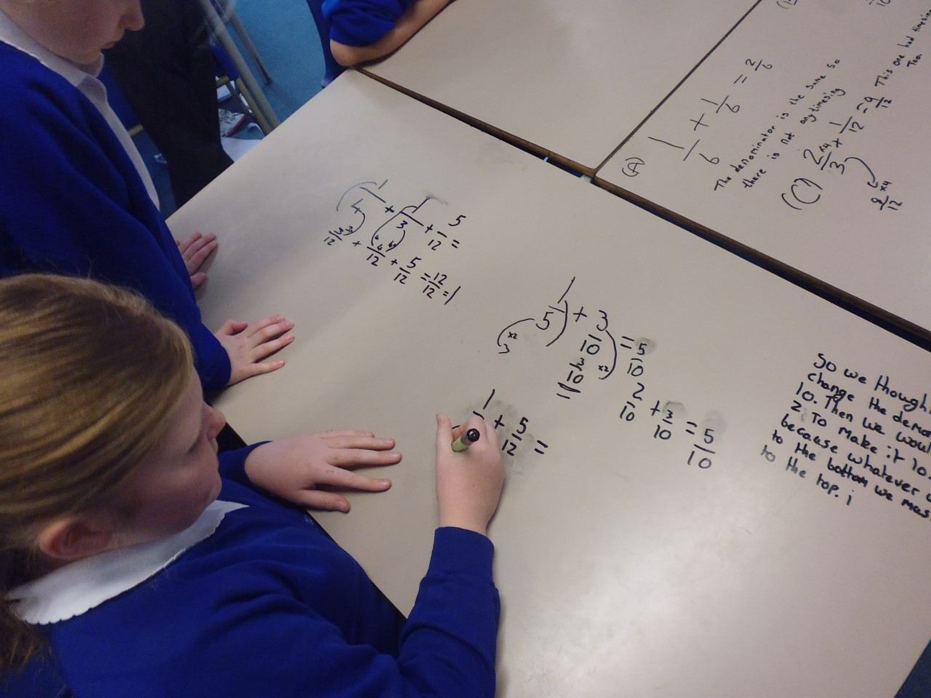
Active learning –

Slide 22
Active learning
What tools do you use in the classroom to help you get up and move around during your learning?
Lily H – I really like being active in the classroom because it means that my brain is working. If I’m sat still for too long it can be boring.
Robert – We use Give One, Get One to share some of our ideas. I like using that when I can’t think of anything and I can get an answer from someone else. It’s like I’m copying but they are giving me the answer.
Maisy – We do Stand Up, Pair Up, Share Up to share our ideas with other people. We have to get up and move around and sometimes I have to give my answer to people who don’t have any answers. I like doing that because I feel like I’m helping them. I also like moving about when I have jobs to do because it helps my brain to be more active/

Slide 23
Active learning –
What tools do you use in the classroom to help you get up and move around during your learning?
Kira – We have actions for different stages of our maths. It kick starts my brain.
Oliver E – Don’t say anything but… Mr Baxter lets us draw on the tables. I really liked that. It was like we were doing something wrong but we were learning too.
Jason – In literacy, Mr Baxter models some actions for the text we are doing and then we go off in groups and we carry on the actions. When we put actions to the text it helps me to remember it.

Slide 24
Where are the children now?
Becoming more comfortable as independent learners
Becoming better at taking risks and challenging themselves
Acknowledging learning behaviours
Still lack overall resilience but developing
More trust in each other and belief in themselves more happy to work collaboratively.

Slide 25
Collaborative learning
How do you work collaboratively (groups/partners)? What helps you?
Lily H – When we do the anchor task in maths, sometimes people don’t understand but that’s ok because I can help other people who don’t understand. We always work in our table groups.
Kira – We work in mixed groups so that if there’s someone that doesn’t understand something then there’s always someone that can help.
Oliver E – I help other people in my table group. I don’t tell them the answer but I go through the problem with them and help them to find ways to solve the problem and then they find the answer themselves.
Robert – I like being able to share my ideas with people on my table and it helps if I’m with people who are of a similar ability. Sometimes though I like sharing my ideas with other people. I don’t tell them the answers, I just help them to solve a problem.
Maisy – We have talk partners to help solve problems with. These might be shoulder partners or opposite partners, which means we get to work with different people. Miss Archer also changes our seats each week so we get used to working with a range of people. I like that.

