Slide 1
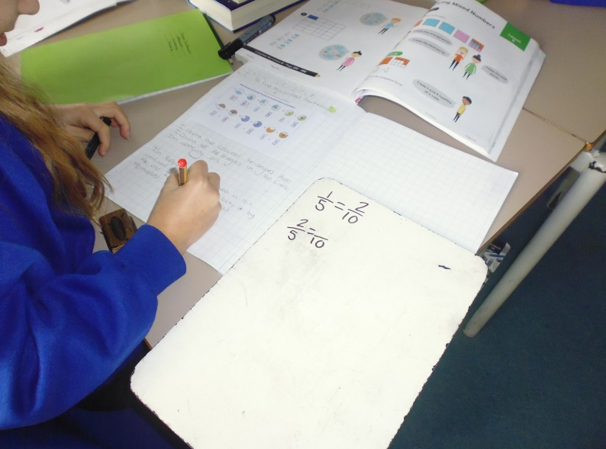
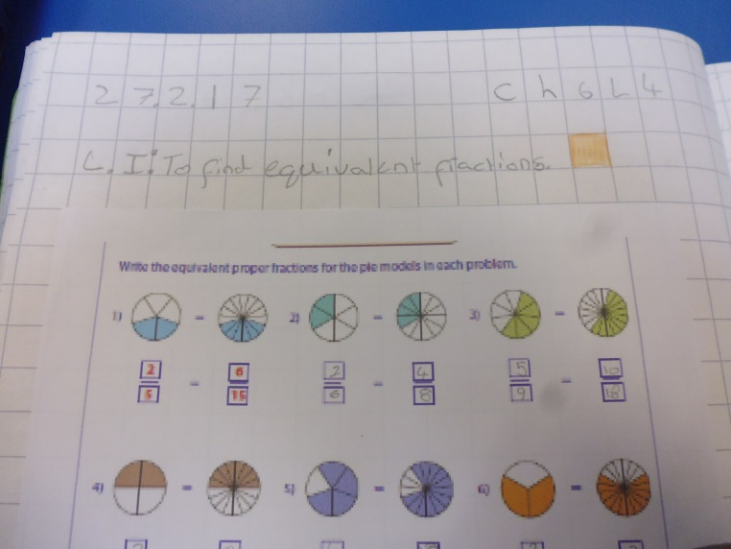
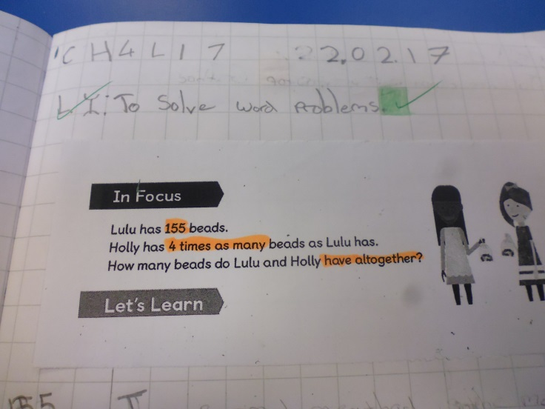
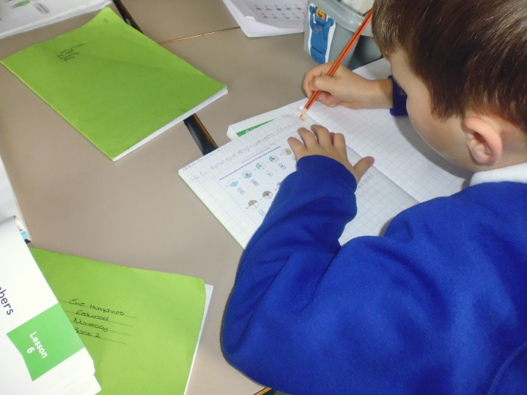
Feedback
Enabling effect feedback to move learning on.

Slide 2


The feedback cycle
Teacher reviews pupil self assessment and adapt planning accordingly
Pupil traffic Light and comment in related to learning intention
Pupils are given time to respond to marking (RTM).
Teacher responds to pupil comment by providing support, giving or extending

Slide 3

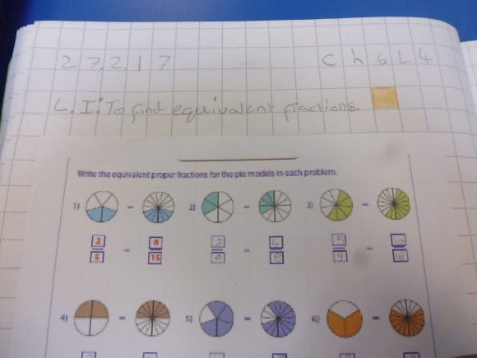
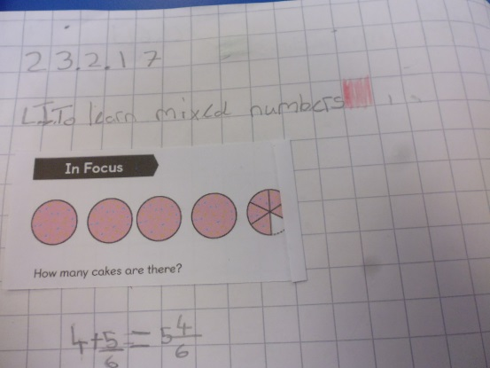
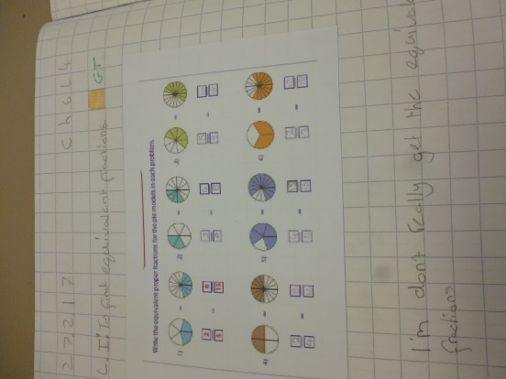
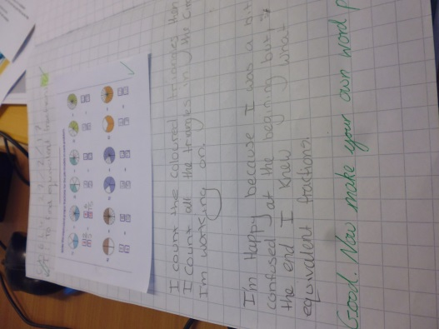
Traffic Light and comment
Pupils express how they feel in relation to the learning intention. They can be green, orange or red
Next, pupils comment more specifically on how they got on - pupils write a comment either below the traffic light or at the bottom of the page. Pupils are encouraged to be specific about what they struggled with.

Slide 4
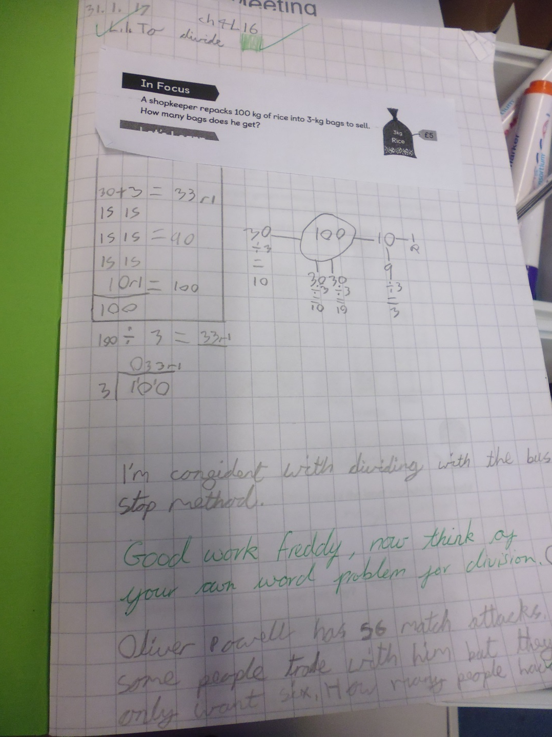
Green – pupil is ready to be extended

Slide 5
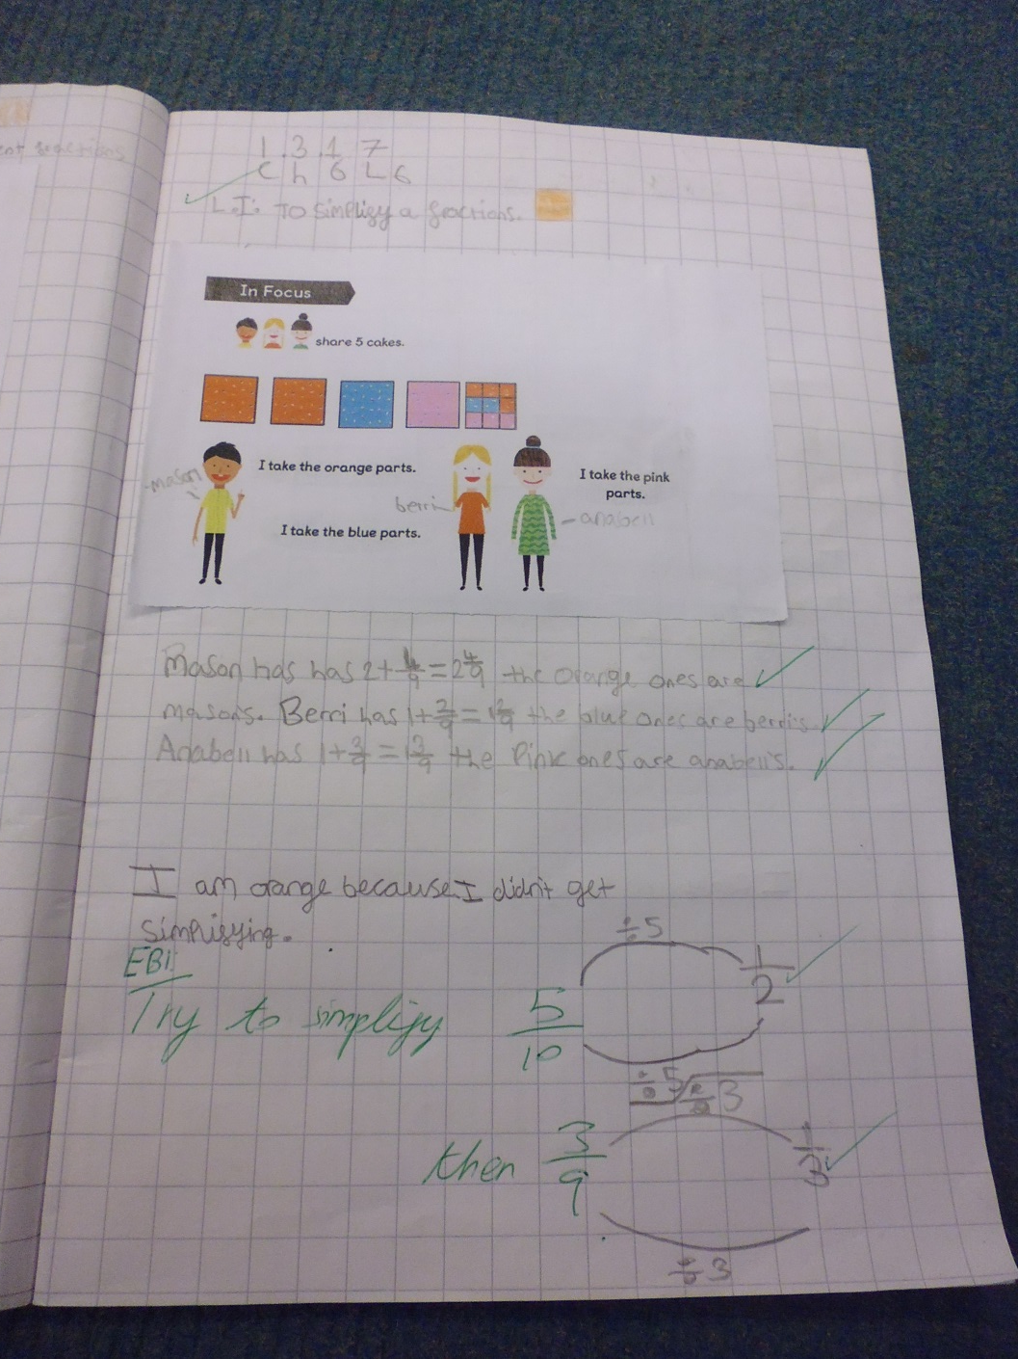
Orange – pupil is unsure about a certain part of the lesson and needs support or further practice

Slide 6
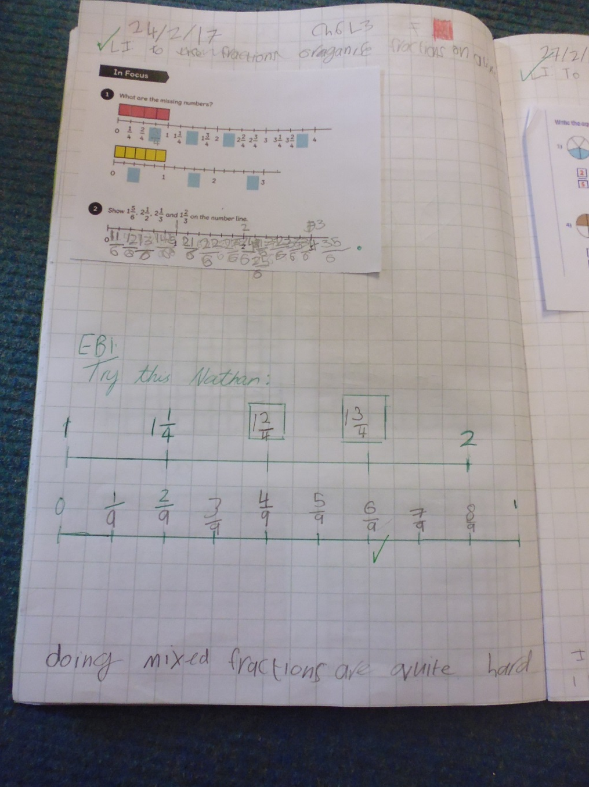
Red – Pupil needs prompting or support

Slide 7
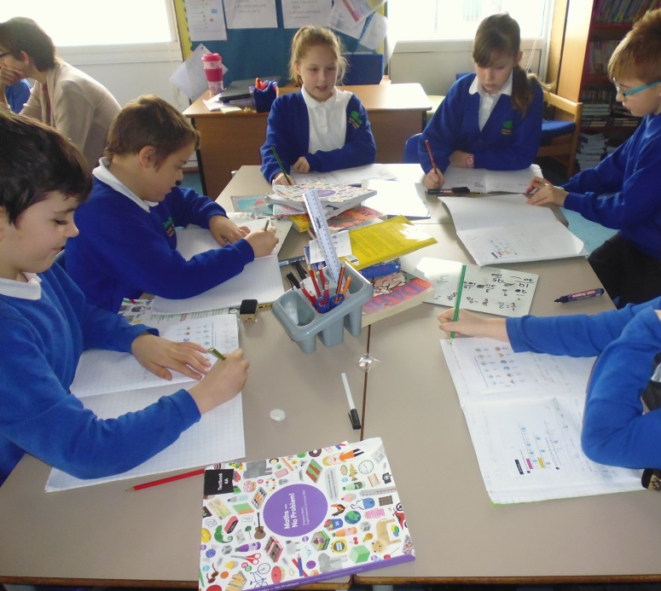
Response to marking time
Pupils are given time to read teacher comment and complete activities.

Slide 8
Adapt planning
Teacher to write comments in planning and adapt the next lesson according to the traffic light and comment in relation to the learning intention.
TA support
Resources
Pre-teaching group
Questioning
Extension activities

Slide 9
What do pupils think?
“If you are on green the teacher can give you a challenge and if you are on red or orange the teacher knows if you need help.” (Freddy).
“If I’m orange you can help me.” (Evie)
“I’m not that keen because I feel rushed to write something.” (Ethan)
“It’s good because then you can help us.” (Beau)
“I like it because I know what I was on that day.” (Tiffany)
“I like to traffic light because it helps other people understand what you think so you don’t have to guess.” (Amelia)
“I struggle because sometimes I don’t know how I feel.” (Phoebe)
“I like it because it helps you think about what you were doing.” (Zara)

Slide 10
Final thoughts
Traffic lighting and commenting the LI helps pupils to become more self aware
Pupils need to be given sufficient time during the end of the lesson to reflect and comment
Some pupils need to be given prompts and help to think reflectively
Effective feedback ensures struggling learners are supported and more able pupils are extended

